Slide 1
Course in CAWS: Canada and World Studies
History and Geography:
The World Awaits…

Slide 2
CGG30R – Travel and Tourism
Pre-Requisite:
CGC1D/1P
Culm. Activity: Usually the “Dream Vacation”
Pg. 12 in Course Calendar

Slide 3
CHA3U – American History
Pre-Requisite:
CHC2D/2P
Pg. 13 in Course Calendar

Slide 4
CHW3M – World History to the End of the 15th Century
Pre-Requisite:
CHC2D/2P
Sometimes called Ancient History
Mesopotamia, Egypt, Greece, Rome, and Medieval Europe
Pg. 13 in Course Calendar

Slide 5
CLU3M – Understanding Canadian Law
Pre-Requisite:
CHC2D/2P
Criminal Law
Civil Law
Pg. 12 in Course Calendar

Slide 6
HSP3U/3C – Anthro/Psych/Socio
Pre-Requisite for 3C: None, but ENG2D/2P and CHC2D/2P are good preparation
Pre-Requisite for 3U: ENG2D or CHC2D are good preparation
A good prep for HSB4U: Challenge and Change
Pg. 20 in Course Calendar (In Social Sciences and Humanities Dept. but taught by CAWS!)

Slide 7
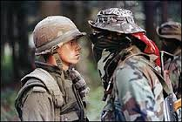
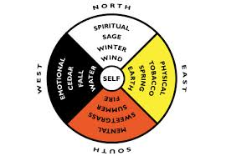
NDW4M – Indigenous Peoples in a Global Context
Pre-Requisite: Any U/C/M level course in Canadian and World Studies or Social Sciences and Humanities
Culminating Activity: The Indigenous Fair
Strong Grade 10 students are often allowed in
Pg. 13 in Course Calendar

Slide 8
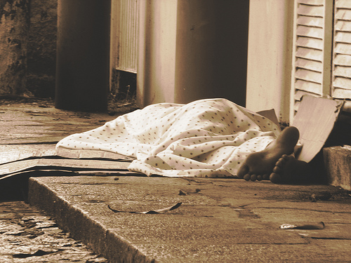
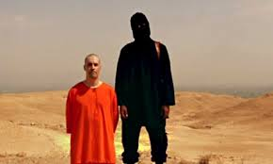
HSB4U – Challenge and Change
Pre-Requisite: Any U/M level course in English, Canadian and World Studies or Social Sciences and Humanities
An excellent preparation for 1st year Psych/Socio/Anthro university courses
Pg. 20 in Course Calendar (In Social Sciences and Humanities Dept. but taught by CAWS!)
Home of the infamous Digital Detox!!

Slide 9
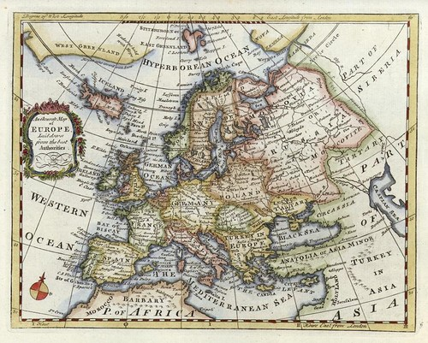
CHY4U/4C – World History: West and the World
Pre-Requisite for 4C: Any U/C/M level course in English, Canadian and World Studies or Social Sciences and Humanities
Pre-Requisite for 4U: Any U/M level course in English, Canadian and World Studies or Social Sciences and Humanities
Pg. 13 in Course Calendar

Slide 10
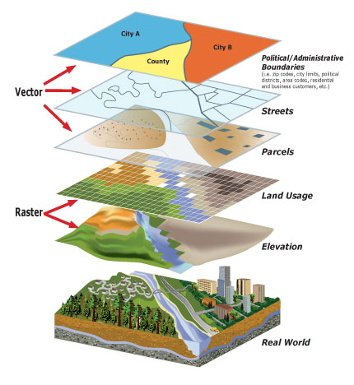
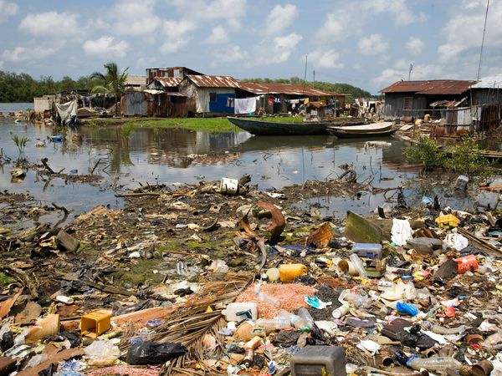
CGR4M – Environment and Resource Management
Pre-Requisite: Any U/M level course in English, Canadian and World Studies or Social Sciences and Humanities
Pg. 12 in Course Calendar

Slide 11
CGW4U – Canadian World Issues: A Geographic Analysis
Pre-Requisite: Any U/M level course in English, Canadian and World Studies or Social Sciences and Humanities
Pg. 12 in Course Calendar

Slide 12
CLN4U – Canada and International Law
Pre-Requisite: Any U/M level course in English, Canadian and World Studies or Social Sciences and Humanities
CLU3M not necessary
Pg. 12 in Course Calendar

Slide 13
HSC4M – World Cultures
First time being offered for next year!
Pre-Requisite: Any U/M level course in English, Canadian and World Studies or Social Sciences and Humanities
Pg. 20 in Course Calendar (In Social Sciences and Humanities Dept. but taught by CAWS!)

Slide 14
Welcome to history and geography!!
If you have questions ask any member of the Canadian and World Studies Department!

