Slide 1
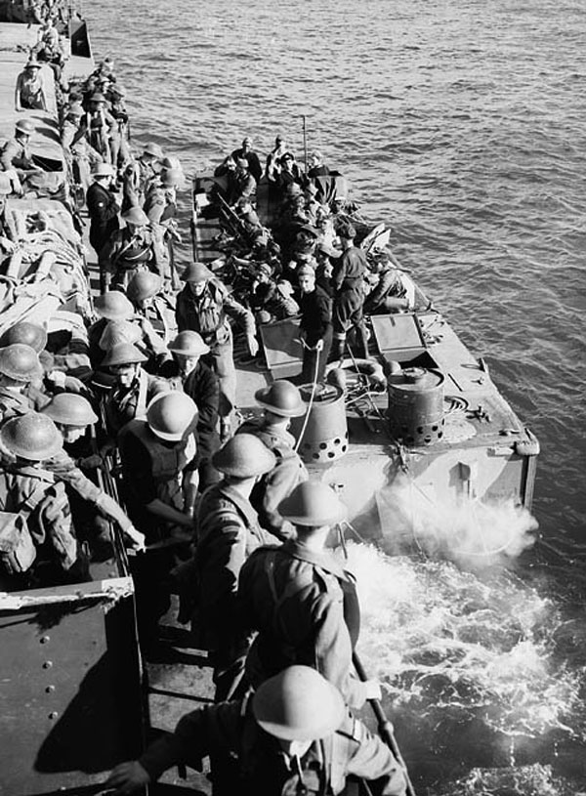
Minds On – Check In
If you were a soldier in the following picture, what are thinking right now? Bear in mind you’ve been away from home for several years, have not seen any action other than training, and you know the German military is very fortified.

Slide 2
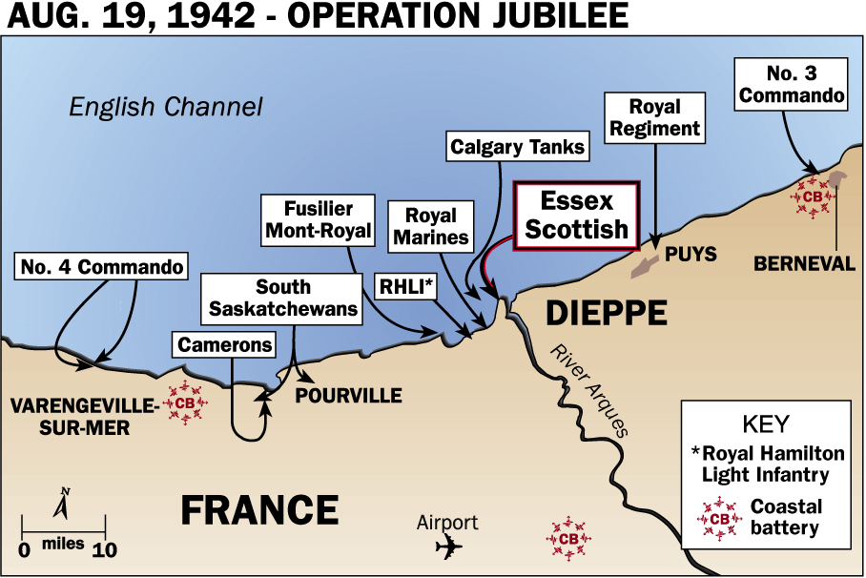
1. How would you rate the Historical Sig. of each battle from yesterday?
2. What are 3 things you remember about the Dieppe raid?
3. Can the way we view an event of the past change over the years? Can that change be meaningful?

Slide 3
Primary Source Picture Analysis
Based on what you learned yesterday and what we just talked about put the pictures you receive in order. With your group be able to describe the events of the Dieppe Raid to match your order.

Slide 4
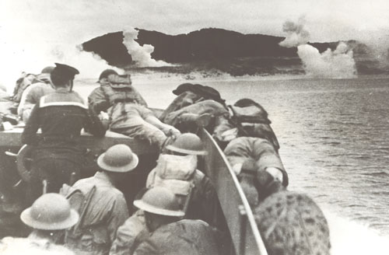

Slide 5
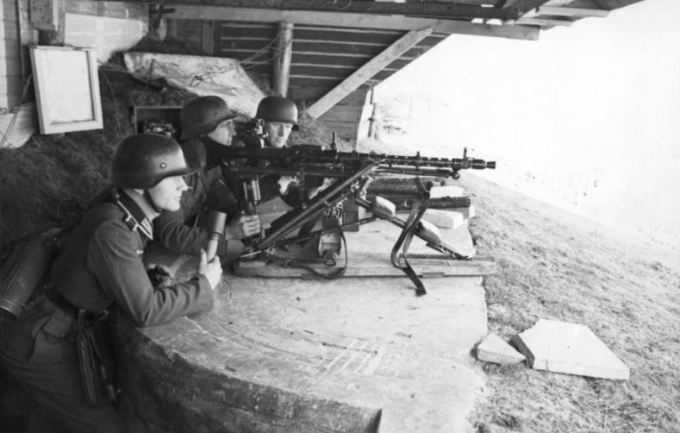

Slide 6
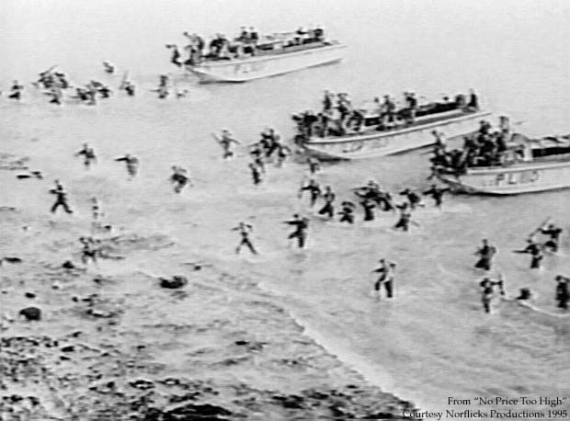

Slide 7
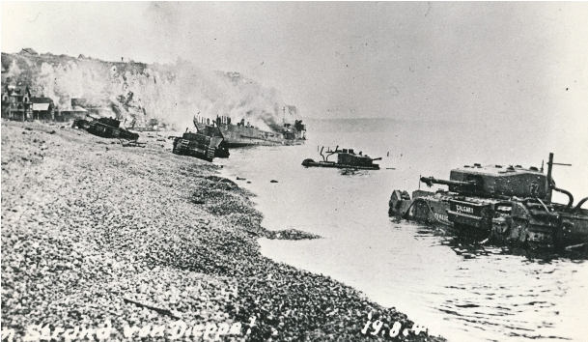

Slide 8
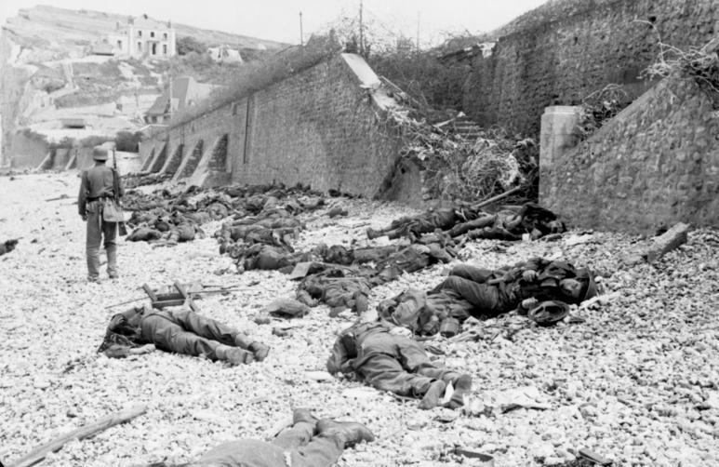

Slide 9
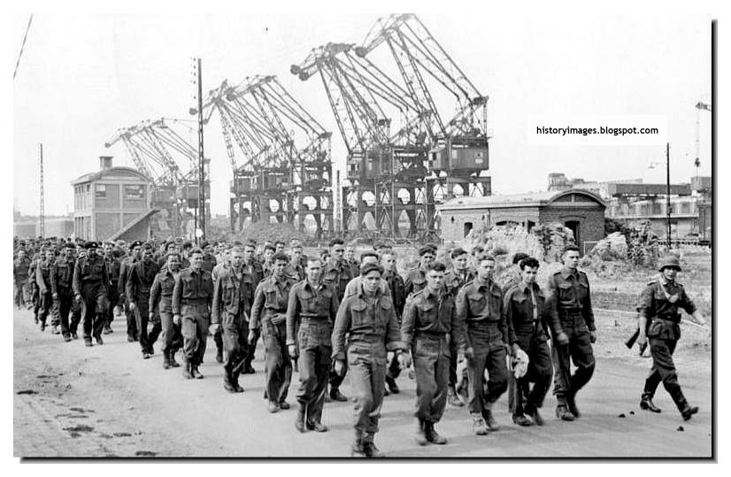

Slide 10
Primary Source Article Analysis
Read the article provided to you as a group. As you read, somebody highlight the statements that appear to be overestimations on the role/importance of Dieppe.

Slide 11
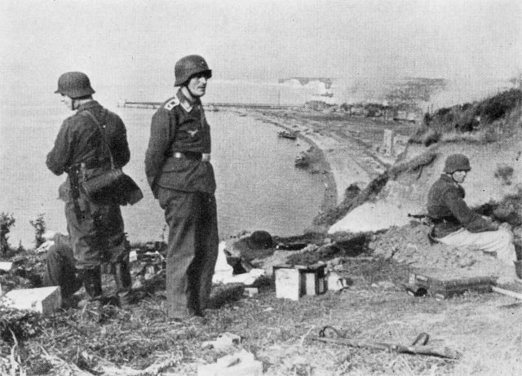
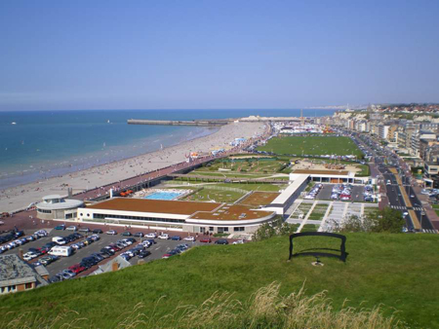
DIEPPE – THEN AND NOW

Slide 12
Dieppe Uncovered: Documentary
1. Set up the following chart in your notebook and take notes while watching the documentary:
Bad Parts of the Dieppe Raid (think of the ways it used to be considered a disaster) | New Evidence to Support a Spy Mission | Reaction and Legacy (How did the surviving soldiers react?)

Slide 13
