Slide 1
Minds On – Quick Review
What are 3 things you remember about life at the home front in WW2?
For each of those, what was the long-term impact (if there was one)?

Slide 2
How Did War Impact Canadians At Home?

Slide 3
Key Terms
CD Howe – “The Minister of Everything” whose job it was to ensure wartime production of munitions and supply
Income Tax/Victory Bonds – These were used again to raise money to fight the war. Victory Bonds alone raised almost $12 billion
Wartime Prices and Trade Board – This attempted to control the economy by mandating a wage freeze but also a price freeze
Rationing – The government issued ration books for basic goods to make sure they were used/shared fairly
Censorship – All communication from the front to home was monitored so no secrets would get out “Loose Lips Sink Ships”

Slide 4
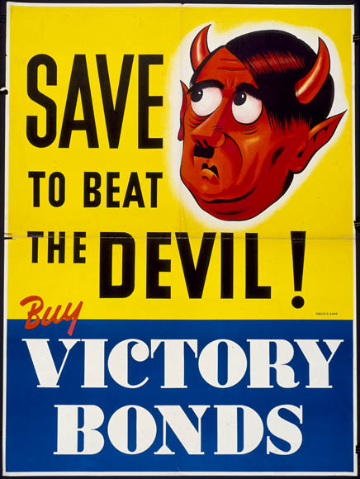

Slide 5
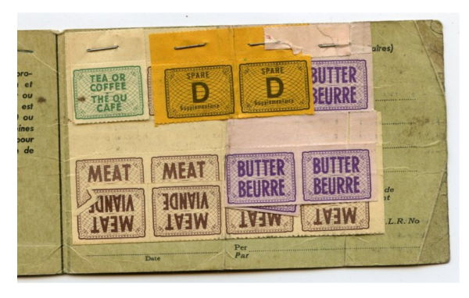
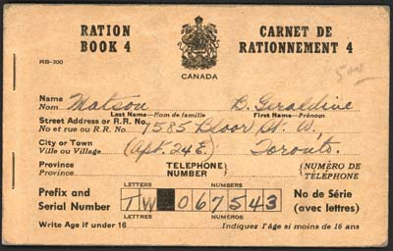

Slide 6
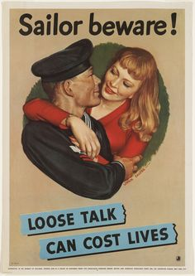

Slide 7
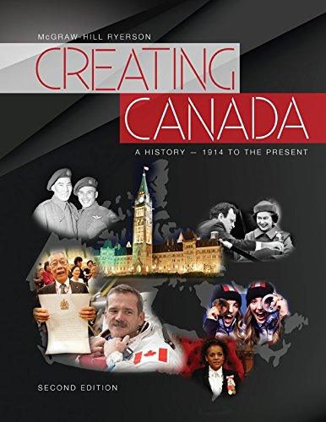
Creating Canada Textbook
Get a Creating Canada textbook and answer the questions on the worksheet provided on your own.

Slide 8
Wrap Up – Yes/No Quick Discuss
Was the apology from the Canadian government to Japanese Canadians good enough?
Was the Canadian government wrong in their treatment of First Nations, Black Canadians and Chinese Canadians in WW2?
Were women treated the best of all the groups mentioned on pg. 298 and your chart.

