Slide 1
Minds On – Quick Share
Tell Mrs. Quackenbush at least 5 things you know about WW1!
As an expert on Geography, ask her why the low-lying grounds of Belgium and other similar areas might not be ideal for a mobile war with tanks and other such weapons?

Slide 2
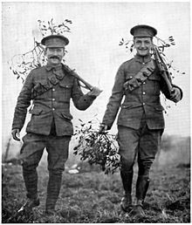
Tech in WW1 – Quick Clip
Watch the Dan Snow clip on “A Soldier’s Kit” (gear) as a class before looking at some specific new technologies of WW1 → → →

Slide 3
Textbooks – Technology in War
Get Creating Canada books
Read Weapons of War (179), The War at Sea (181), The War in the Air (181) and A New Kind of War (182)
Record the required information from your worksheet into the appropriate charts
We’ll take up tomorrow but still get it done! I’ll come around and check.

Slide 4
Small Group Video Analysis
Get into the group indicated on the big sheet Mrs. Quackenbush gives you.
On one of your phones go to YouTube and look up the video indicated on the page.
On your sheet write down any information that:
discusses why it was an effective technology or addition to WW1
Any information that discusses why it was not effective
How you think that type of technology or addition to WW1 works or is seen today (not in video but you guys are smart enough to think about it!)
Put your sheets on the board and be prepared to discuss!

Slide 5
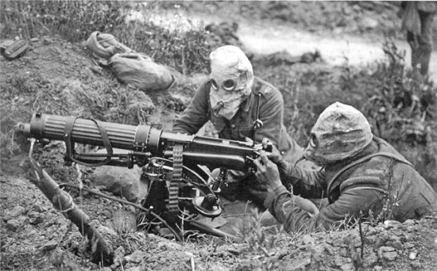
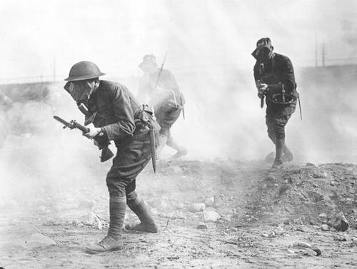
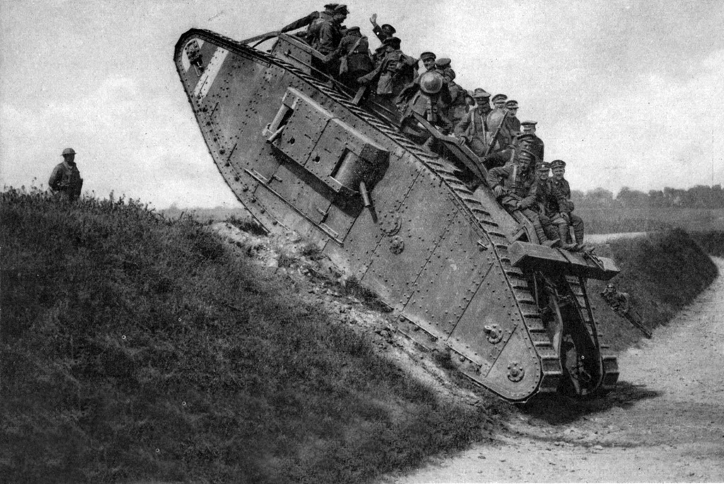
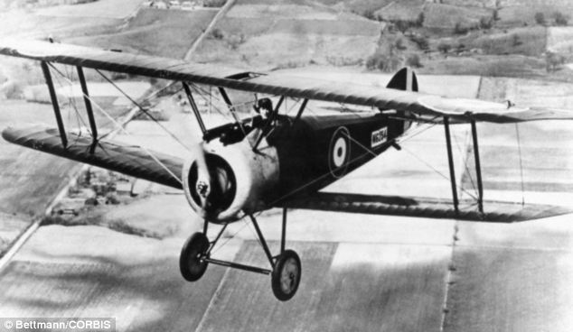
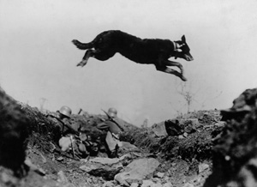
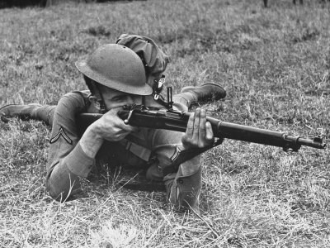
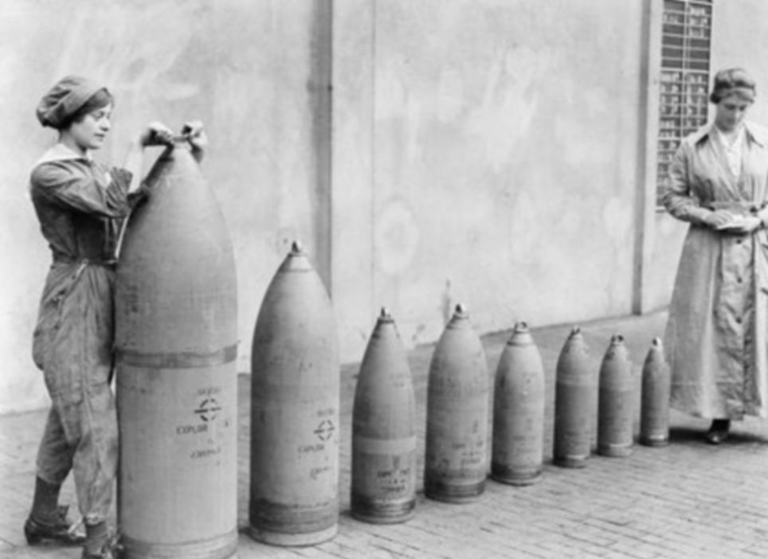
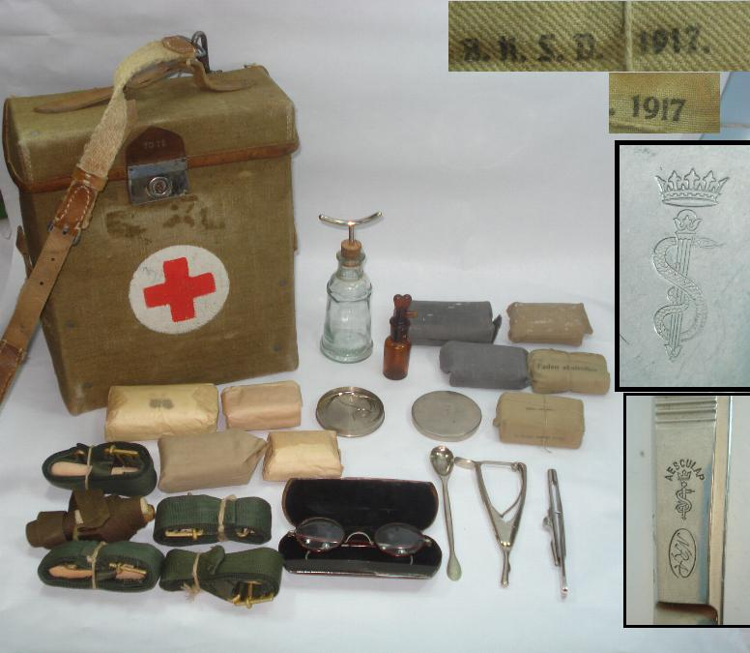
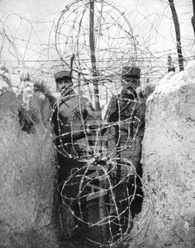
Discuss and Watch!
A few fine volunteers I’m sure will discuss their technology (or addition to WW1) and then you can watch the video after each one to finish up the class. (Clips linked to pictures)

