Slide 1
Minds On – Quick List
What type of groups do you consider yourselves part of?

Slide 2
Social Bond Theory Recap
Attachment (to conventional others)
Commitment (to conform/goals)
Involvement (makes for a more positive experience)
Belief (in rightness of rules)
Only feel slightly bad when I can’t make it, and really only to the people who I like more
Play by the rules, come prepared to games, shake hands with other teams, thank refs, etc.
A good social involvement, helps keep old guys in shape and off the couch, but takes away from marking/parenting time on Mondays
Believe the league should be fair, should stick to rules est. at beginning of year, game should be played the right way

Slide 3
Social groups and comparisons

Slide 4
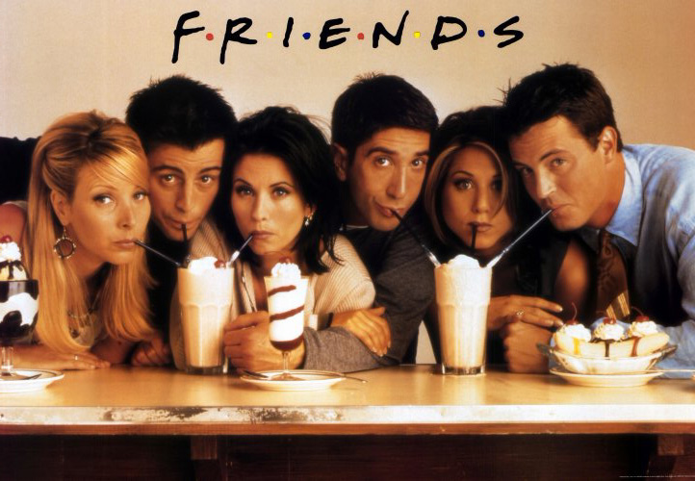
Opening discussion
What draws people together?
4 Elements of a Social Group
Regular interaction and influence
Something in common
Consensus on beliefs, values and goals
Formal or informal structure
How are the above characteristics evident in this clip, or even in your own social group?

Slide 5
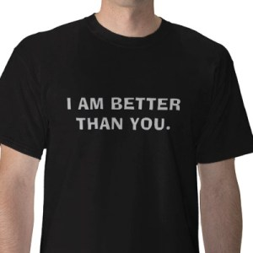
Social Comparison Theory (Louis Festinger) is the idea that we are constantly comparing ourselves to others in order to define our own sense of selves and abilities

Slide 6
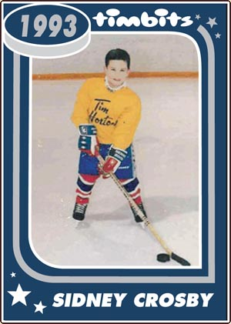
Upward Comparison
When we compare ourselves with those who we believe are better than us.
This often results in the desire to improve our current level of ability and develop strategies to attain that.
Although not according to Festinger, it might also make us feel worse.

Slide 7
Downward Comparison
Comparing ourselves to someone who is worse off
The general purpose of this comparison is to make us feel better about ourselves
(We might not be great at something, but at least we are better off than someone else.)

Slide 8
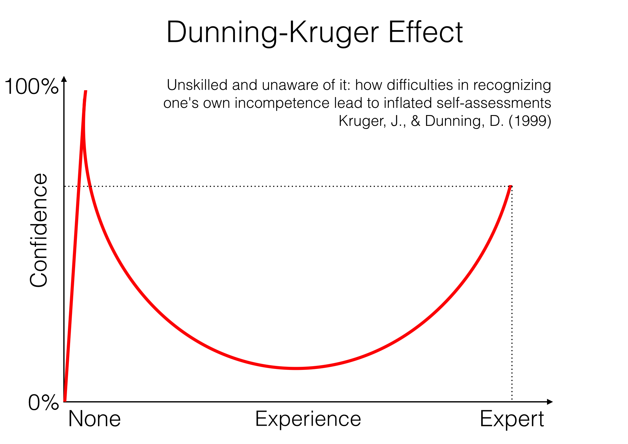
Dunning-Kruger Effect
Developed in 1999 (David Dunning, Justin Kruger), this theory states that incompetent people can’t recognize their own incompetence and tend to overestimate their actual abilities.
Also known as the Imposter Syndrome.

Slide 9
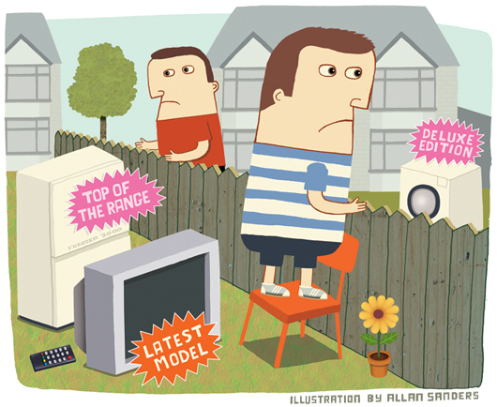
Other Terms
Competitive Emulation: Keeping pace with others in terms of material goods and lifestyle
Conspicuous Consumption: Acquiring/displaying expensive items to prove/suggest wealth
Conformity: Matching attitudes/behaviours to what we believe to be ‘normal’ to society or our social group

Slide 10
Article – “I Coulda Been A Contender”
Pre Reading: List 3-5 goals/dreams you have for your life
Questions
Based on the front page, is the author engaged in upward or downward comparison?
Describe what she calls ‘the Contender Syndrome.’
How might social networking make our lives worse this way?
The author upwardly looks at Tina Fey. What celebrity do you (realistically) look up to and why?
What do you think is meant by being ‘self-referential?’
What is the relationship between the ‘actual self,’ the ‘ideal self,’ and the ‘ought self.’
What would a Neo-Marxist think about all this?
How can you beat the Contender Syndrome (and how have you done these things anyway)?

