Slide 1
Mind’s On – What Would You Do?
Here’s the scenario… War has just broken out and as a teenager you can’t enlist to fight yet. For each one of the suggested contributions below just make a little check mark in the margins if you would do that to help.
Plant a vegetable garden so you can send the vegetables overseas to help feed the soldiers
Loan money to the government to help finance the war effort
Work in a factory to make war materials like rifles, artillery shells, tanks, grenades, etc.
Organize a fundraising event to raise money for the war (e.g. a dance, card party)
Donate money to soldier’s families who were barely surviving on the income their loved one made
Knitting clothing and bandages to send to the soldiers
Work on a farm to help raise food production
Pay a new, but temporary tax during the war to help raise money
Control food and household items to try and live off less in order to send extra supplies and food overseas to the soldiers
Add them up! Do you think you would be a good Canadian and be a good contributor to the war effort?

Slide 2
War on the home front

Slide 3
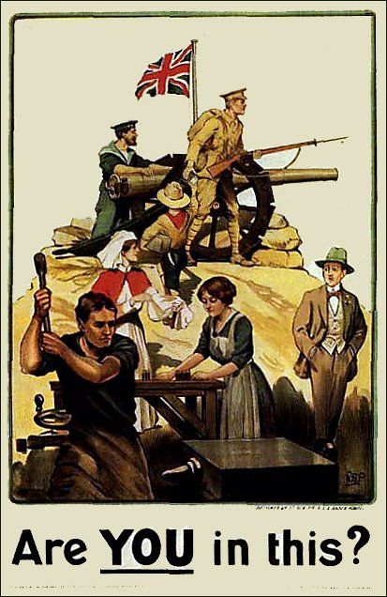
WW1 was considered a total war as it enlisted the effort and energy of everybody
Interview Activity: You will be given a sheet with 2 questions. For both questions you will ask 5 different people for their response/perspective to that question (meaning you will talk to 10 people in total!) Record their responses (word for word!) and be prepared to discuss similarities/differences and any other points of interest.

Slide 4
Home Front Interview Activity questions
How might this period be a turning point for women in Canada?
What groups in Canada do you think had the most difficulty during WW1?
Which regions or groups might have benefited the most during WW1?
What laws/policies would you recommend to make lives easier for people living in Canada at this time?
How do you think news of the battles was received by people living in Canada?
What do you think Canadians hoped to gain (personally or as a nation) as a result of WW1?

Slide 5
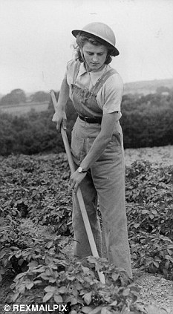
Roughly 60% of early recruits were farmers. This greatly disrupted the industry. Later on they were exempt from duty.
Need for food production exploded to supply allies
Women and city workers helped on the farms

Slide 6
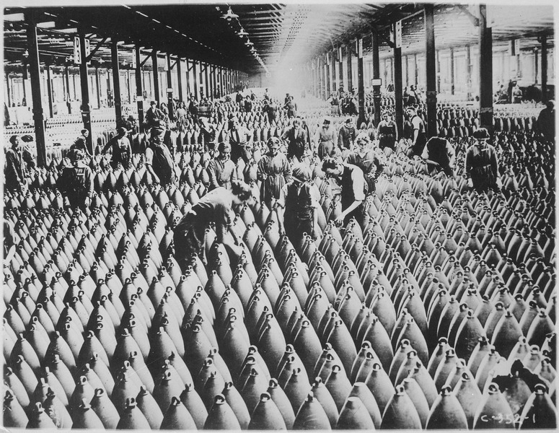
Canada’s industry greatly contributed to the overall Allied effort and built guns, planes, shells, etc.
We were safely across the ocean to produce weapons, but had to transport across the Atlantic (the convoy system)

Slide 7
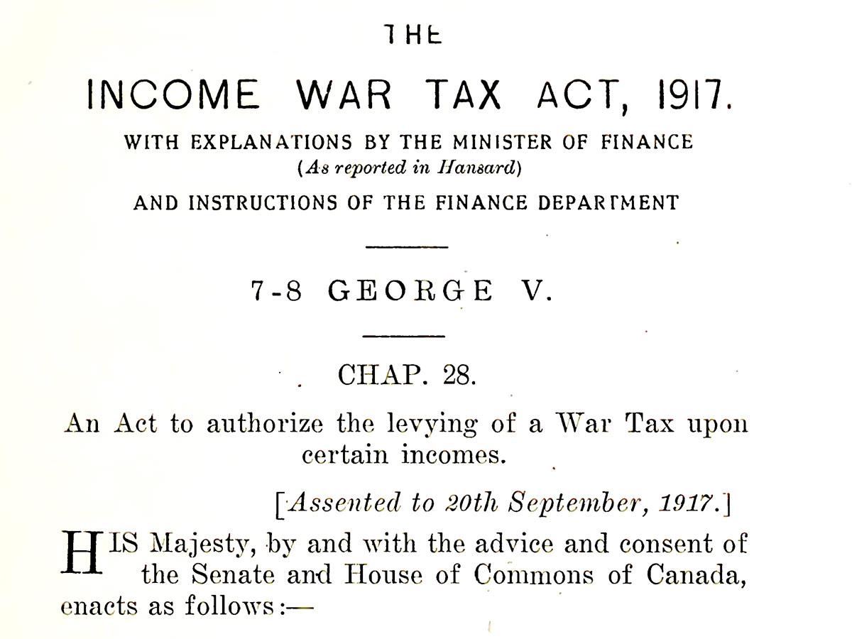
As of 1917 enlistments are at an all-time low and public support is falling.
The war was costing $1 million a day. Although Victory Bonds were initially successful people cannot afford to give anymore – A new “temporary” tax was introduced to help.
Also, 1917 was an election year for PM Borden!!

Slide 8
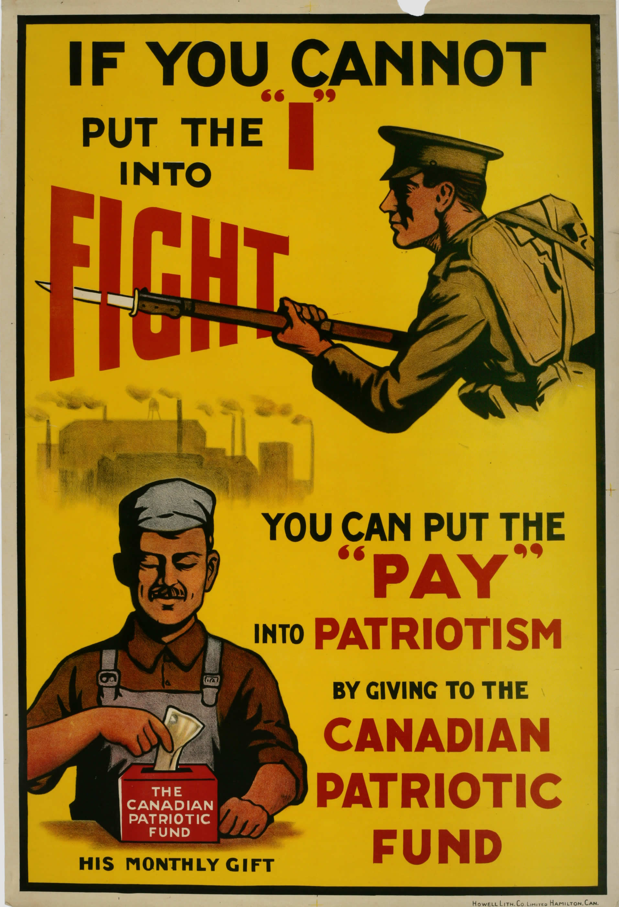
Our War – Canada’s Home Front Video
Write down the title above and set up the following chart:
Would our contributions be the same based on the concept of Historical Perspectives?
5 Contributions | Why were they doing that? | Why wouldn’t we do that?
1. 2. 3. 4. 5.

