Slide 1
Mind’s On – Effort Assessment
Quick show of hands! Based on what we know who would categorize Canada’s effort in the war to this point as a success?
Why do you think this? If you’re not sure what further questions do you have?
Yesterday many of you said that you had heard of D-Day before. What are a few things you know?

Slide 2
D-Day: The Beginning of the End June 6, 1944

Slide 3
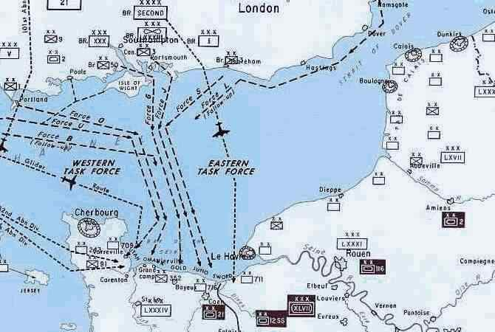
The Plan
The goal was to penetrate “Fortress Europe” and push the Germans back
The official name was Operation Overlord

Slide 4
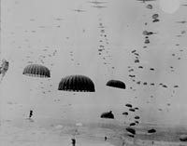
The Attack
This was a combined Allied effort – US, British and Canadian
This was a 3 dimensional battle: used air, sea and land forces
It began with paratroopers at 2:30 a.m. and forces started invading the beaches at 6:30

Slide 5
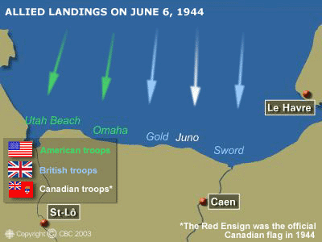
What Did Canada Do?
We gave paratroopers, soldiers, over 100 naval ships and airplanes
We landed at JUNO BEACH
We were the only Allied force to meet objective for the day – Take the beach and gain territory

Slide 6
Group Discuss: Corroborating Evidence
Task:
Get into groups of 3
As a group read the 3 accounts on D-Day.
After you will discuss how they are similar and how they differ.
Based on your investigation/discussion you will decide which one is the most credible in determining the legacy of Canada and D-Day.

Slide 7
Source 1 Account of Canada’s success at D-Day John Maker, Canada War Museum The Canadian assault beach at Juno was among the more successful. Canadians began landing at around 7:30 in the morning. The assault batallions took heavy casualties in the first waves. Through strength of numbers, fire support, artillery, and armoured squadrons, by about two hours after landing they had started to come off of the beach and began landing their reserves about an hour after their initial landings. The reserve brigade, which brought in three new batallions, came in at about 11:30 in the morning. At the end of the day, June 6, the Queen’s Own Rifles had actually captured its objective, which was short of the overall divisional objective but goes to show that some of the Canadian units were quite successful in the first hours.

Slide 8
Source 2 Article on overall success of D-day Anthony Beevor, The Guardian It is too easy to look back on the Normandy landings of Operation Overlord and assume that success was inevitable because of the allies' overwhelming strength. In fact, the break in the weather that allowed the invasion to go ahead was critical. The German navy never put to sea on the night of 5 June, and despite the legend of "bloody Omaha", allied casualties were far lower than the 10,000 expected. With around 3,000 servicemen dead, the figure was no more than the number of French civilians killed that day.

Slide 10
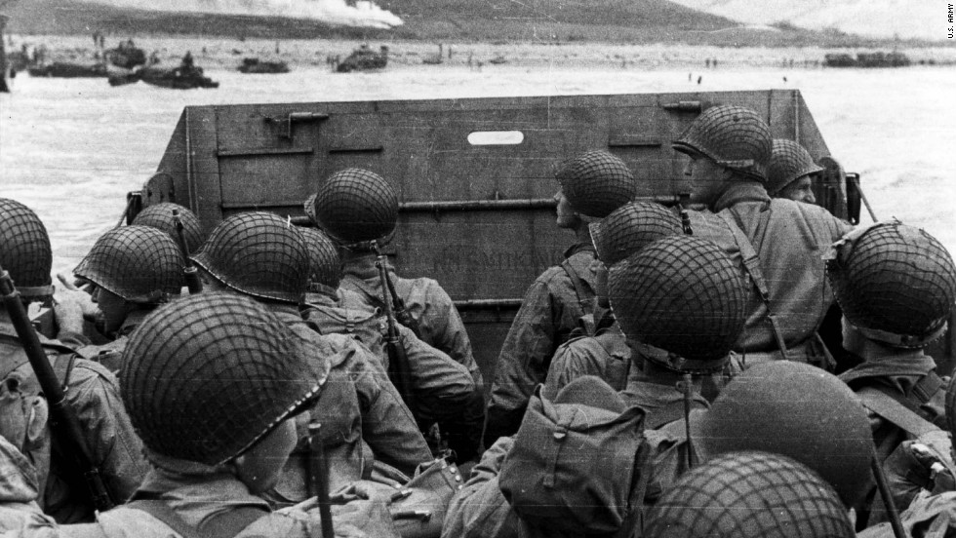
The Real Saving Private Ryan
Many of you have said that you’ve seen Saving Private Ryan. Here’s the real story.

