Slide 1
Minds On – Quick Write
On your own, write down how each group of people would be feeling after D-Day and as the Allies are battling with the Germans. After each one discuss as a class.
Allied soldiers
German soldiers
Citizens in France, Belgium, Netherlands
Citizens in Germany

Slide 2
From D-Day to Liberation

Slide 3
Overall Effort and Impact
Over 156 000 Allied troops landed on D-Day
Roughly 30 000 were Canadian
Within a month 1 million Allied soldiers had landed
The Liberation of Europe had begun – This was The Beginning of the End for Nazi Germany

Slide 4
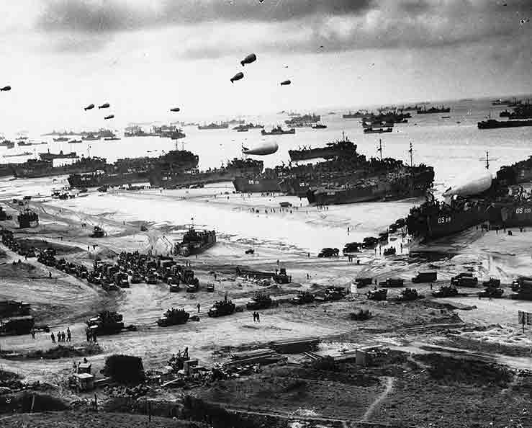

Slide 5
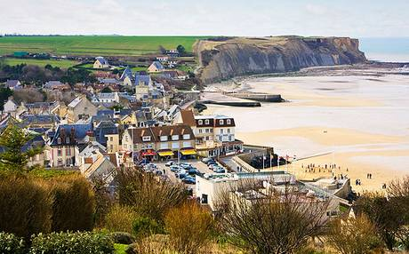
Clip – Canada’s Role at D-Day (12 minutes)

Slide 6
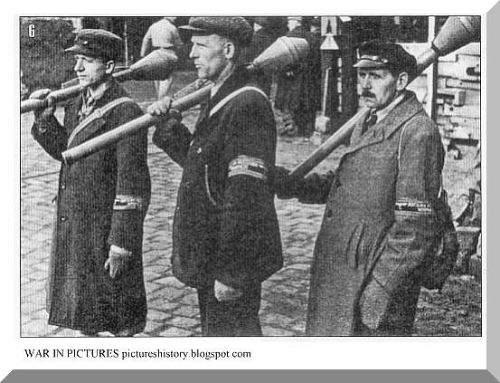
Liberation of Europe
From D-Day to April 1945 pushed the Germans back to Berlin
They are also being surrounded by the Soviets from the East
The final defence of Berlin included young boys and the elderly – The German army was defeated

Slide 7
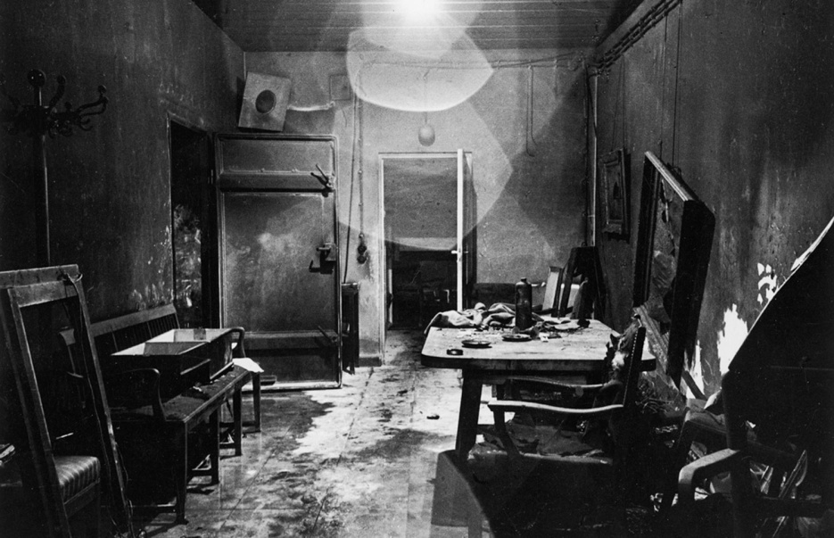
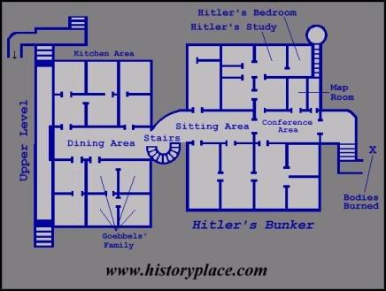
Hitler commits suicide on April 30, 1945. He orders his body burned afterwards as he does not want his body captured
Nazi propaganda says he died a hero’s death leading his troops in battle (Video Clip → Watch until last 5 minutes of class then put up Wrap Up question)

Slide 8
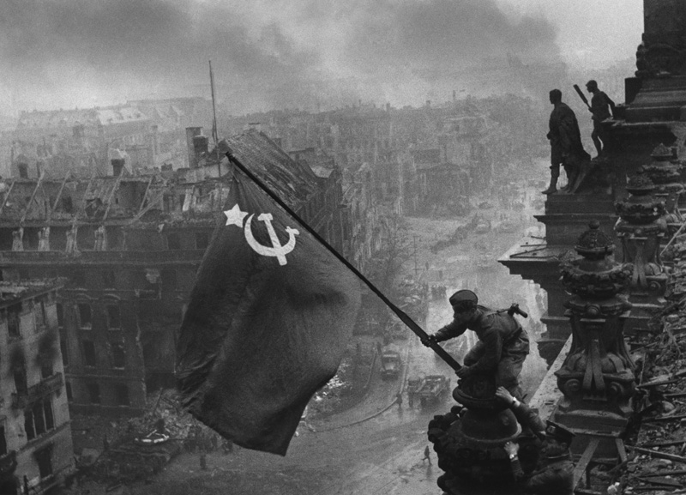
VE Day
One of Hitler’s final orders is to fight to the death
Germany formally surrenders May 8, 1945
Although this is very important, war still continues in Japan

Slide 9
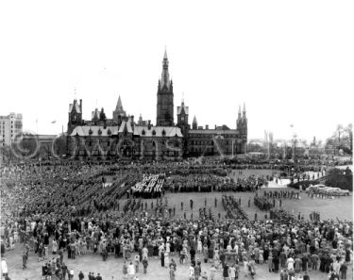
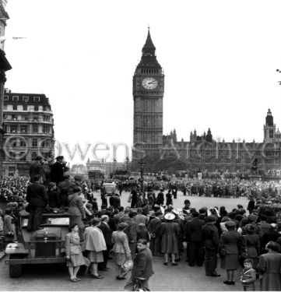
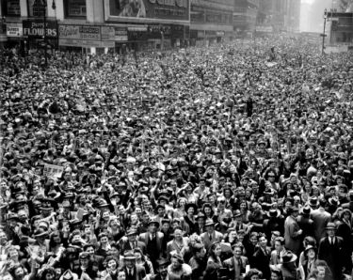
The World Celebrates!
Parliament Hill, Ottawa
May 8, 1945
Parliament, London, England
Times Square, New York

Slide 10
Wrap Up – Next Steps
Tomorrow’s opening question (and yes, Mr. Shields will be here!) will be very simply:
War in Europe is over. What next for the soldiers, the citizens, and the ruined cities?
Think about it.

