Slide 1
Mind’s On – Group Share/Discuss
Go to the side of the room that most reflects your opinion on the matter of social justice and crime. With the people of shared opinion make a list of why on the sheet provided and post it when done (5 minutes)
The justice system we have is suitable for our society
The justice system we have is unsuitable for society
The justice system we have needs to be reformed (but there’s no point as crime will still occur)
The justice system we have needs to be reformed (and here’s how)

Slide 2
Crime and social Justice

Slide 3
Crime Defined
Crime is a deviation from formal social norms and carries with it formal penalties (sanctions)
Sociologists are concerned with changes in crime as it reflects changes in society as a whole and how we tolerate/deal with crime
Of particular interest are the inequities we see in crime and the justice system

Slide 4
Types of Crime
Violent: Acts which result in death or injury (homicide, assault, rape, robbery)
Property: Acts threatening property owned by individuals or the government (theft, embezzlement, arson)
Victimless: Illegal act in which there are no readily apparent victims (gambling, drug use, prostitution)

Slide 5
Textbooks – Looking at the data
Turn to the section starting with “Likely Offenders” (pg. 193-198, but not the blue pages) and make a chart like the one below:
Look for minimum 5 pieces of data (at least one from each section) that you think is important in explaining crime from a sociological point of view. Think of possible reasons/solutions for each one and be prepared to discuss
Evidence | Possible Reason | Possible Solution

Slide 6
The correctional system
Based on 4 Principles:
Retribution
Social Protection (Segregation)
Rehabilitation
Deterrence
Discuss with partners and then as a group:
Which do you think is the most important principle in our justice system?

Slide 7
Textbooks one more time!
Make a chart like the one above and fill it in based on the section on Restorative Justice on pg. 201
After you’ve formed your opinion on Restorative Justice answer Q4 at the bottom of the page. Did it change your opinion?
Pros | Cons

Slide 8
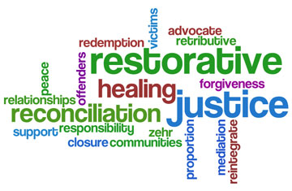
Wrap Up – Video response
As you watch the attached talk think of two sides of the issue: Is Restorative Justice good for society or is it an ‘easy out’ for the offender?

