Slide 1
Mind’s On – In Their Shoes
The war is over! Think about the perspectives of each of these people.
A woman who worked through the war. What is her future like?
Someone who spent the past few years in an internment camp. Will Canada welcome them back?
An Aboriginal soldier who fought well and was awarded medals. Will Canada welcome them back?
A soldier who was conscripted and saw little or no action in the last months of war.
A soldier who enlisted in 1914 and survived the whole war.

Slide 2
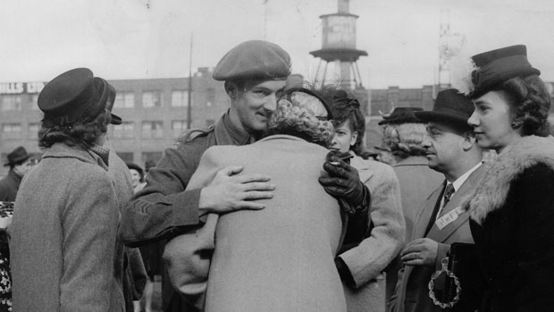
Post War Issues in Canada

Slide 3
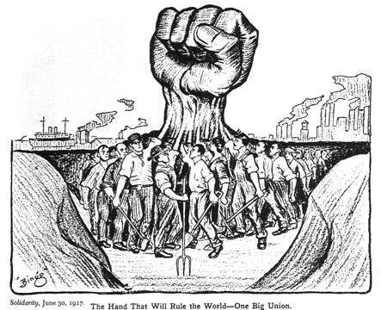
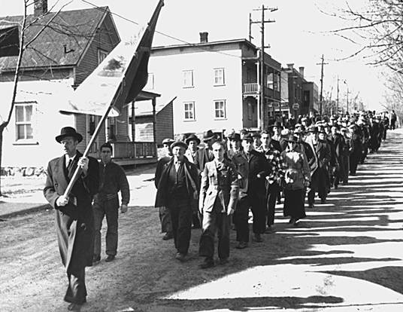
Jobs: Soldiers returned home expecting a heroes welcome; they found a changed nation and a lack of jobs. There was an economic recession until 1923.
Labour Unrest: Those that could find work had terrible conditions. The rise of unions – organizations who bargained for workers rights – was gaining popularity.

Slide 4
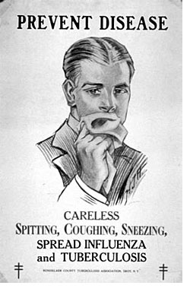
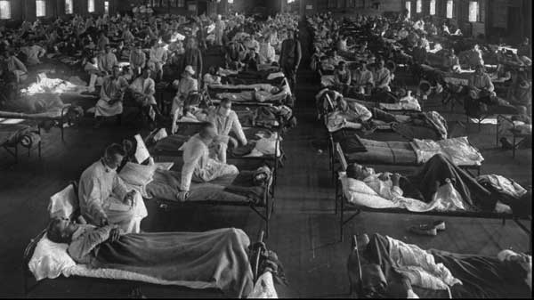
Women: Despite their efforts and new rights in WW1 women were told to return back to the home after the war.
Influenza Pandemic: Known as the ‘Spanish Flu’, this killed over 50,000 Canadians. To compare, the war itself killed over 60,000. (Video Below)

Slide 5
Partner Discuss – Fair or Unfair?
Go through each scenario and discuss with the person closest to you. After you’ve discussed each with your partner discuss as a class.
You and a co-worker are both equally competent and both ask for a raise. He/she is given one, you are not. Fair Unfair
You are dealing with a significant issue at home and request a day off to deal with it. You are denied. Fair Unfair
You have been injured on the workplace and the Dr. recommends you need 3 weeks off to recover. You do not get paid anything during that period. Fair Unfair
You have been injured on the workplace and the Dr. recommends you need 3 weeks off to recover. Your employer replaces you and you are now out of a job. Fair Unfair

Slide 6
Creating Canada – Text Questions
Read the ‘Voices’ section on pg. 208. Based on that, what immediate thought do you have about unions?
Read ‘Voices’ on pg. 207. How does that compare? Which do you believe?
Read ‘Labour Unrest’ (pg. 206) What were Canadian workers demanding?
Read ‘One Big Union’. a) What was the purpose of the OBU? b) Why was the government afraid of unions? c) What is a general strike?
Read ‘Winnipeg General Strike’ and give a brief summary of events.
Read ‘Opposition to the Strike’ (208) and give a brief summary.
Read the information for Figure 7-14 and answer the question: Do you think it could have been handled differently?
Read ‘Consequences of the Strike’. What were some of the lasting impacts?

