Slide 1
Headlines
Black students hindered by academic streaming, suspensions: Report
Ontario launches basic income pilot for 4,000 in Hamilton, Thunder Bay, Lindsay
Action needed now to avert GTA homes crisis
Toronto’s art school students mostly white, from high-income families, study finds
Ontario urged to track foster kids after they leave care

Slide 2
Minds On – Quick Compare
After each statement consider this very simple question: Are they equal?
Jim and Tim grew up in the same neighbourhood and went to the same schools.
Jim got slightly higher grades (3-5% more) all the way through K-12.
Jim went to Queen’s and Tim went to Lakehead and they both received a degree in the same discipline.
They both entered the same profession and receive the same salary.
Jim had wealthy parents and did not have to pay for university. Tim had to take on OSAP for his entire degree and came out of school with considerable debt.
Because of this Jim had a large down payment for his house, has a stylish car, and takes regular vacations. Tim has to make significant student loan payments and has none of the above.
How can any the terms from yesterday can be applied?

Slide 3
Text Ques. Take Up
How does social class connect to social mobility? Why might it be difficult to move upwards from the lower class to the middle or upper?
Is the social class system a useful way to understand society or does it create inequality among different groups?
Why do most people find talking about their own social position awkward?

Slide 4
Picture Analysis
For each picture very simply write or discuss:
Who are these people and what is their circumstance?

Slide 5
Picture 1

Slide 6
Picture 2

Slide 7
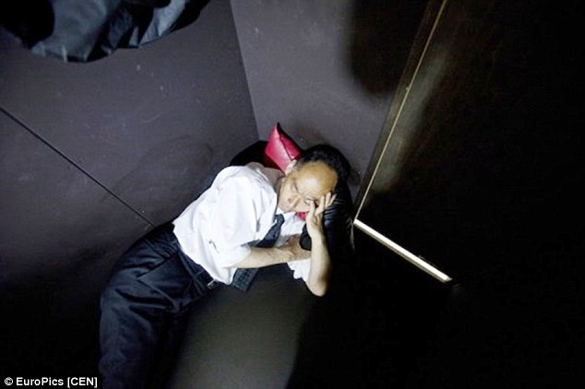
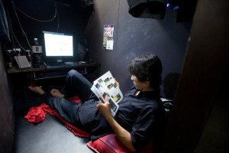
Picture 3

Slide 8
Poverty
According to Statistics Canada it is impossible to define poverty, especially as there is no singular international definition.
Absolute Poverty – being deprived of resources considered essential
Relative Poverty – measuring those who are deprived of resources against those who have more
Measuring relative poverty is done by a system called the Low Income Cut Off (LICO). This is often referred to as “the poverty line”

Slide 9
Get Out Your Calculators!
If you have a job, calculate roughly how much your earn a month before taxes and deductions
Next, identify 3 things you consider necessary that you have to pay for with your own earned money
How much money do you spend on those 3 necessities a month?
What percentage of your income is that amount?

Slide 10
According to the LICO, the average Canadian family spends 35% of their pre-tax income on necessities – food, shelter and clothing
If a family spends over 55% of their income on those necessities they are considered poor by Statistics Canada. Using this method 15-20% of Canadians are considered poor

Slide 11
Textbooks!
Read “Poverty” on pg. 174/175 and answer 1,2,4 on pg. 176
1. Income is what you earn/receive while wealth is what you have/accumulate.
2. People with higher incomes have more disposable income. They can buy the things that all might want. Those things can become the symbol of stratification.
4. Social structures impacting poverty can include poor/disadvantaged neighbourhoods, high crime rates, other illegal activities, poor government intervention, discrimination, lack of education, etc.
Read “Point/Counterpoint” on pg. 174 and do the questions ON YOUR OWN. We’ll discuss after.

Slide 12
Minds On – Two Sides
Very simple: Make a t-chart with Yes or No on either side.
On your own or with the person beside you, give reasons for both perspectives on this question: Is inequality inevitable in our society?
Yes | No

Slide 13
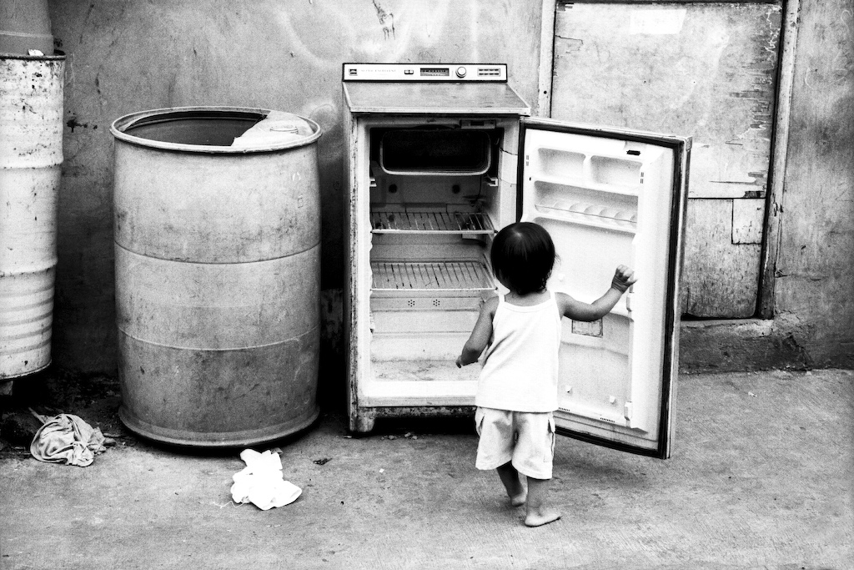
Wrap Up: Class Discuss
Watch the attached clip
After watching the clip, get in a small group and analyze the issue of poverty/homelessness according to the terms indicated on the sheet.
Post and be prepared to discuss

Slide 14
Wrap Up: Post It
1. Despite both statistics and actual stories on the issue of poverty in Canada, why does there still seem to be a stigma surrounding the poor?
2. What are some factors that make it difficult to respond to the challenges of poverty?

