Slide 1
Minds On – Get a Job! Think/Share
With your partner or group and discuss the profession you have been given. Good things, bad things, etc.
If I was your employer what are the most important things you would ask for to have a good working environment? Write them down and be prepared to discuss.
If I refused, what options might you have?

Slide 2
Support for the Strike?
With your partner, discuss why people go on strikes:

Slide 3
The Winnipeg General Strike

Slide 4
Key Terms
Union – An organization among trades/workers to protect and further employment rights.
Socialism – An economic system based on government control of the economy so all people benefit.
Communism – A political belief where the worker has significant control of the means of production. Modern communism originated in Russia (Karl Marx) and led to Russian Revolution.

Slide 5
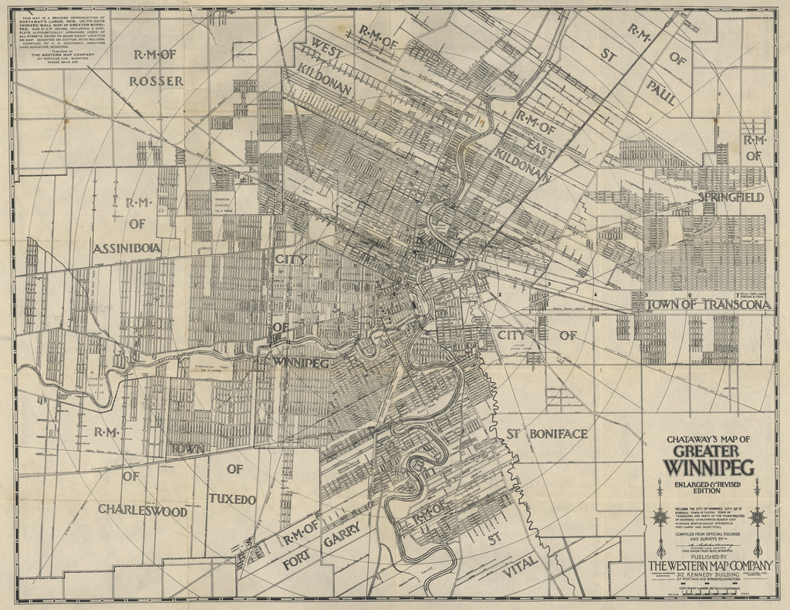
Winnipeg General Strike - Summary
In 1919 Winnipeg was a divided city. There was a hug gap between the rich and the poor.
Many of the poor lived in the ‘north end’, and they also happened to be of Russian or other eastern European backgrounds
This gave rise to the fear of communism – a political belief where the worker has significant control of the means of production – that was present in Russia/Soviet Union

Slide 6
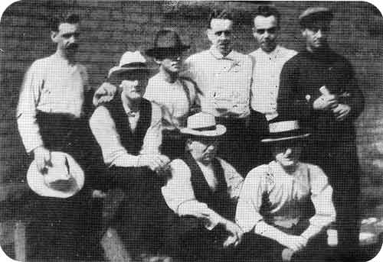
From May 1-15 over 20,000 people from a variety of unions walk off the job and grows to over 30,000
They want to negotiate: better hours, improved wages ($0.85 an hour!)and the right to collectively bargain
Winnipeg essentially shuts down

Slide 7
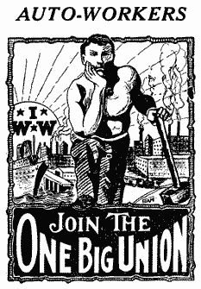
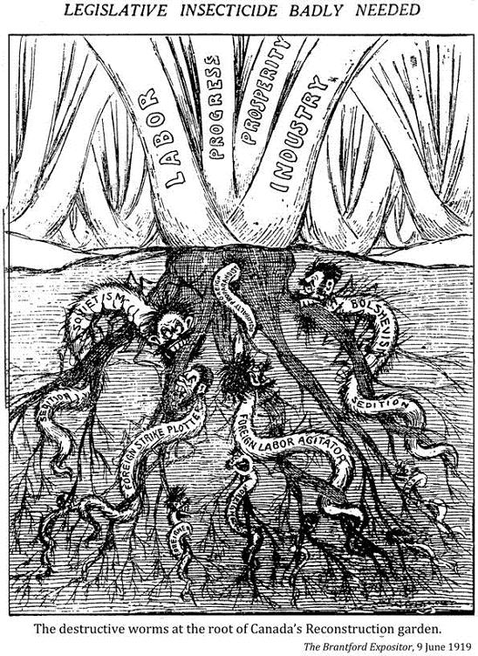
Primary Sources – Poster Analysis
Of the posters you have, which ones do you believe are ‘pro’ and ‘anti’ union. Be prepared to discuss.
What types of images/words characterize both the ‘pro’ the ‘anti-labour’ posters? What might this tell us about the concept of Historical Perspective?

Slide 8
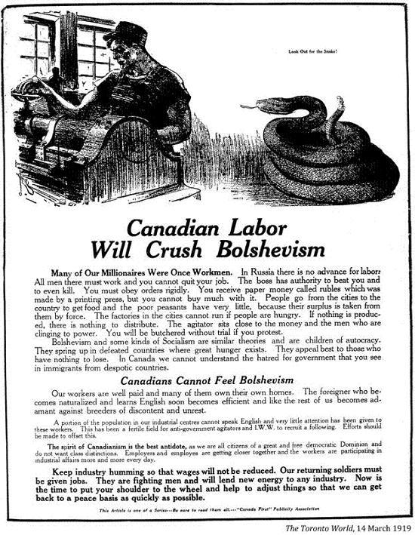
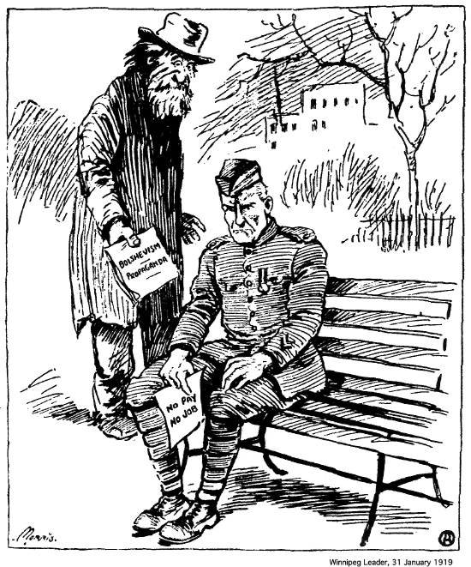
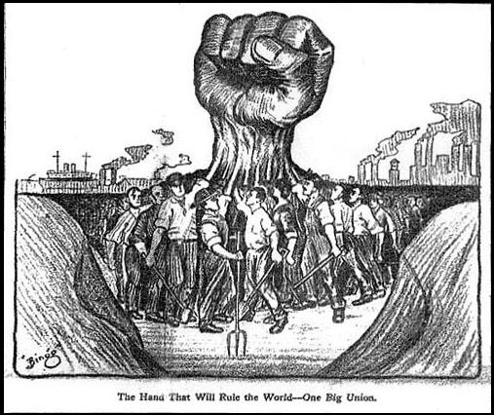

Slide 9
Opposition – Summary
An organization of business leaders (The Citizen’s Committee of 1000) meet to strategize an end to the strike.
They blamed the strike on immigrants (calling them “communists”, and “alien scum”) and meet with the government.
The government refused to meet with the strike leaders.
The Strike culminates in Bloody Saturday on June 21, 1919 where 2 men were killed in a conflict with the RCMP

Slide 10
Bloody Saturday – CBC Documentary

Slide 11
Consequences of the Strike
Negative:
Many saw the strike as a failure
Some workers forced to sign non-union contracts
Classes in Winnipeg continue to be strained
Positive:
Many realized how important “the working class” was
Many strike leaders went on to positions in politics

Slide 12
Wrap Up – Key Questions
Half of you will be 1, the other half will be 2
Using the note/video/brilliant commentary of Mr. Shields, write a brief answer to either question:
How could the Winnipeg General Strike be considered an internal conflict in Canada?
How did the social/political movement of the Winnipeg General Strike impact Canadian identity?

