Slide 1
Mind’s On – Gen Z Myths
Take a minute and discuss myths about Gen Z with your partner
As a class let’s determine if there is truth to these stereotypes
Class Discuss – Where do these stereotypes/myths come from?

Slide 2
Generational Theories

Slide 3
Social Scientists study similarities and differences among generations and how they lead to change in society
This also helps clarify views among the generations in order to better understand relationships between them

Slide 4
The historical era we are born into defines our worldview: these values form the basis for our personal and social behaviour
Is there any potential risk in using Generational Theory?
Possible stereotyping and negative interaction

Slide 5
Karl Mannheim
Mannheim suggested that age groups (also known as cohorts) share core ideals they will hold on to through their collective lifetimes
This is based on your social location – your birth year – where you will always share the same social context and occupy the same space in history
This is based on the notion of fresh contact – The personal interpretation of the world collected when we’re young that gives meaning
Discussion Question
Which School of Thought applies best to this idea?

Slide 6
Strauss-Howe Theory
William Strauss and Neil Howe further developed Mannheim’s research
Their theory is based on archetypes – Universally understood symbols or patterns
These eras result in shared outlooks and values

Slide 7
The four archetypes (or ‘turnings’) are: the Prophet, Nomad, Hero and Artist
According to Strauss-Howe, each full generation/turning rotates after an 80 year period and gives way to the next (although they can overlap)
This cycle always has a crisis that results in great change and as such defines the generation

Slide 8
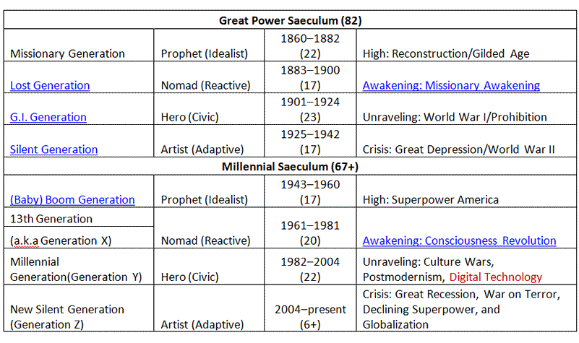
Check Out Some Generations (Quick Video Too!)

Slide 9
TextBook Questions – Gen Z and Work
Read the section on Employment Trends (pg. 126-128) and answer the following in your notes:
What does studying employment tell social scientists? Can you think of an example?
What types of jobs do students typically get?
What impacts can working have on a teenager?
Why are young workers more likely to experience unemployment during a recession?
How might upward/downward comparison play into the social stigmas discussed on pg. 128?
Why are young people more likely to move for work?

