Slide 1
Mind’s On – Post War Predictions
In your notes jot down 3 predictions for Canada and/or the world after WW2 (take 1 minute – quietly and on your own!) These ideas can be social, political, economic, etc.
Take 1 minute to compare/discuss with the person beside you
Take a few minutes and discuss as a class

Slide 2
Canada and the world: Post ww2

Slide 3
Canada After WW2
The world was now living in a nuclear age
This created a large sense of fear and insecurity
Organizations to protect the world would now have to be put in place
In our age of ‘code-reds’ how does this compare? →

Slide 4
What is a Cold War?
The world was dominated by the Cold War from 1946-1990
It was ‘fought’ by the US and the Soviet Union (Russia)

Slide 5
It is an “idea war”
Both sides believed in different political systems
The US (the west) believed in democracy and capitalism
The Soviet Union (the east) believed in a one-party communist dictatorship

Slide 6
The Cold War was also an arms race.
Each side was spending more on its military than they were on food, housing, education and medicine

Slide 7
Germany – What Now? (Don’t Need to Write Down, Just Discuss)
After the surrender of Germany, the country was divided up between France, the USA, Britain and the USSR.
The city of Berlin was also divided
As a result western Europe, including western Germany was much more prosperous than the Soviet ‘eastern bloc’

Slide 8
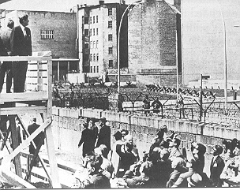
Kennedy at the Berlin Wall

Slide 9
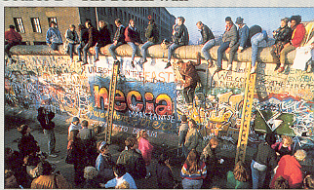
The Berlin Wall in 1989

Slide 10
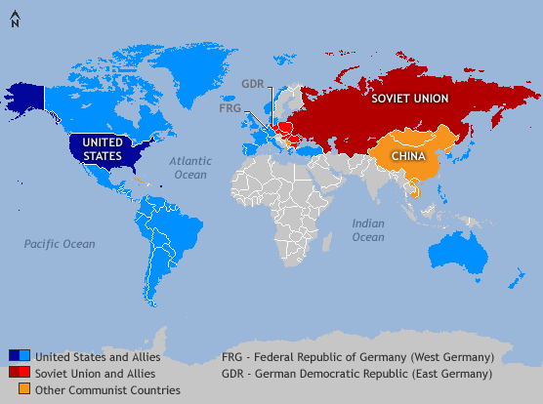

Slide 11
Cold War Terms
Step 1: Before you use the textbooks to investigate/define the following terms check off the ones you know (or think you know) a bit about on the left.
Step 2: Use the index of Creating Canada to investigate/define a variety of terms connected to Canada during this era.
Step 3: After you investigate/define all the terms put a star beside the 5 you want to know the most about.

Slide 12
Textbook Reading – Igor Gouzenko
With the Gouzenko Affair it can be said the Cold War was sparked in Canada
Read the section on pg. 280-281 and answer the questions in your notes (and discuss after) before watching this last clip →

