Slide 1
Minds On – Inquiry Question
Write the following question in your notes: Why are the 1930s judged a dark time in history?
On your own or with a partner, brainstorm possible reasons that could answer this question (based on what you know or think you know)
Is it fair to history to assess the 1930s in this way?

Slide 2
Picture Inquiry
With does the picture you get suggest about the Historical Perspective of the time? (Trying to understand history in context, but without applying our own values) Discuss with a partner/group and be prepared to discuss as a class.
Also consider what questions you’d like to ask further about this picture.

Slide 3
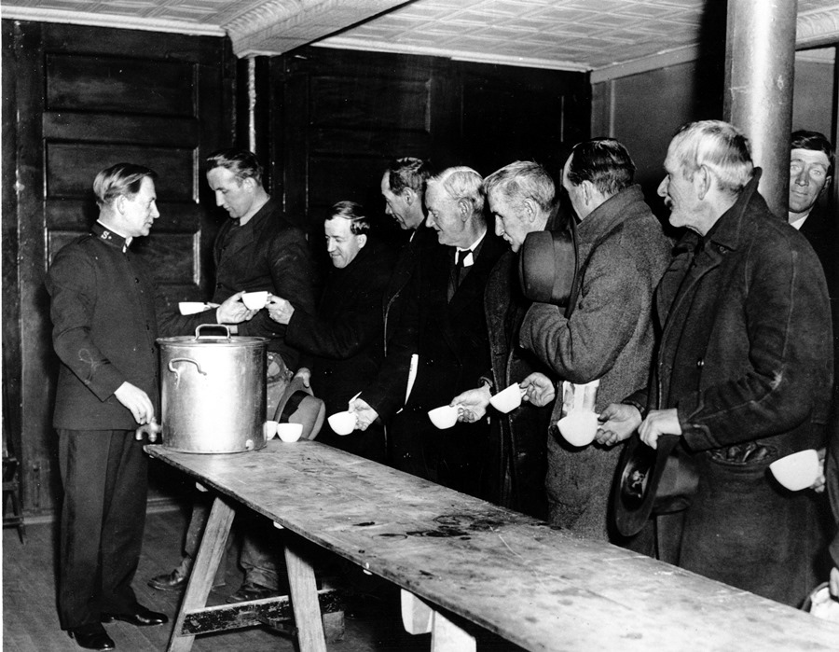

Slide 4
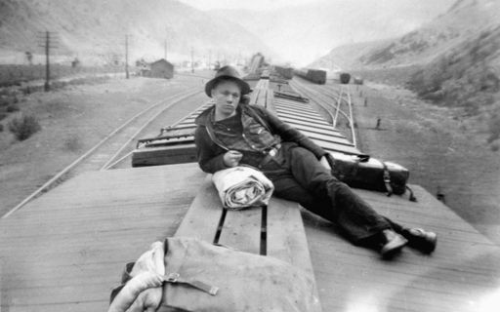

Slide 5
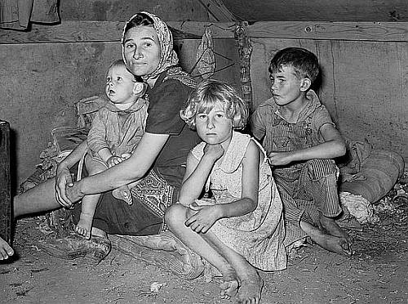

Slide 6
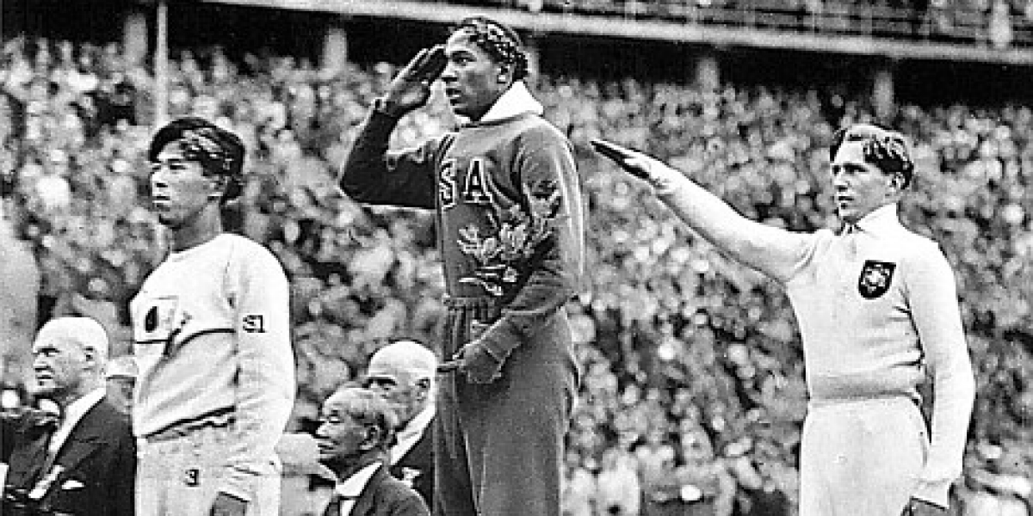

Slide 7
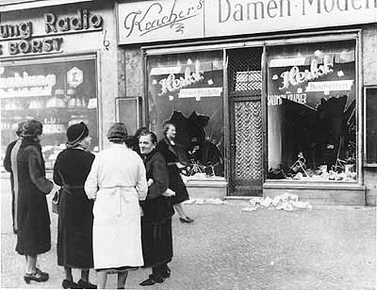

Slide 8
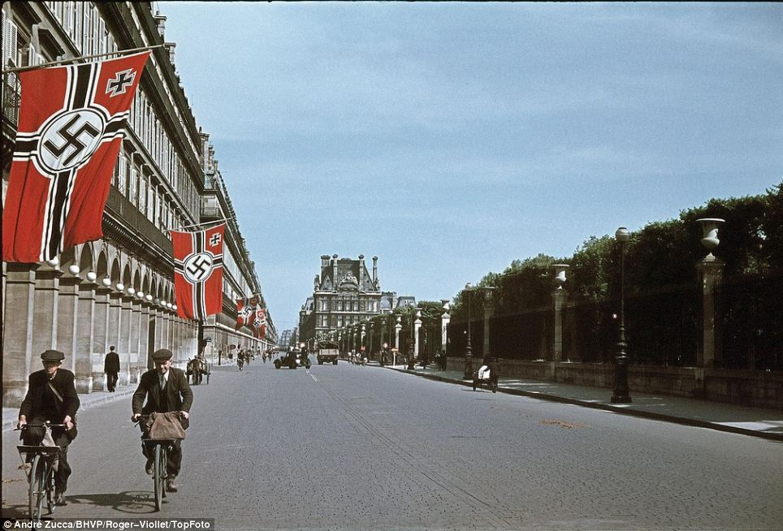

Slide 9
Canada in the 1930s

Slide 10
By the late 1920’s people had certainly gotten used to “the good life”
The new middle class was enjoying leisure time and extra money to its fullest
Things that people didn’t consider were:
Was the economy as stable as they thought it was?
What would our relationship with Britain and the US continue to look like?
Would European conflict once again impact us?

Slide 11
Textbook Inquiry: Exploring Ideas
Step 1 – Get a Creating Canada textbook
Step 2 – Copy down Figure 9-10 on pg. 256
Step 3 – Here’s where you get to think! Put a star beside the 3 your think are most important
Step 4 – Copy the following chart and fill in blanks based on which causes you felt were most important:
Cause |  | Consequence (short term) |  | Consequence (long term)
1. | …was an action that led to… |  | …and…
2. | …was an action that led to… |  | …and…
3. | …was an action that led to… |  | …and…

Slide 12
Exploring Ideas Recap
Cause |  | Consequence (short term) |  | Consequence (long term)
Many people borrowed (too much credit) | …was an action that led to… | People not being able to pay and the bank wanting their $ | …and | Banks having to repossess goods and even lose their own $
Wheat demand goes down (Canada) | …was an action that led to… | Farmers not farming! Not buying machines, etc. | …and | Other jobs/industries that rely on farming fail
Companies out of business/layoff workers | …was an action that led to… | People out of jobs, can’t spend | …and | Companies have too much product/surplus
Tariffs are raised on international goods | …was an action that led to… | People/businesses encouraged to ‘buy Canadian’ but can’t | …and | International economy crumbles
People sell stocks to pay off debts | …was an action that led to… | The stocks losing value and companies failing | …and | Stock brokers desperate to get $ back (margin calls)
Black Tuesday | …was an action that led to… | NYC stock market crash | …and | THE GREAT DEPRESSION! (The US coughs, the rest of the world gets sick)

Slide 13
Group Discussion – Product Review
On the next slide I’m going to show you a product you’ll all remember (and many of you had, I know!)
With your partner/people close to you I want you to discuss:
Why were these so darn popular and reasons you think the business was a huge success
Reasons you think they went out of business and why these aren’t popular today
How could this connect to the Causes of the Great Depression?

Slide 14
Why were these so darn popular and reasons you think the business was a huge success
Reasons you think they went out of business and why these aren’t popular today
How could this connect to the Causes of the Great Depression?

Slide 15
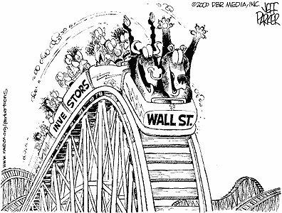
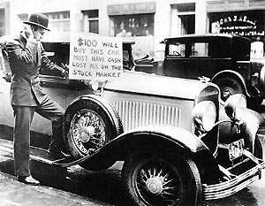
Black Tuesday
During the 1920's, many people played the stock market – Stocks were investments in companies
By 1929, stocks began losing their value
On October 24, 1929, thousands of stocks that were bought on margin were dumped on to the stock market
Investors panicked, and within days, these stocks were worthless

Slide 16
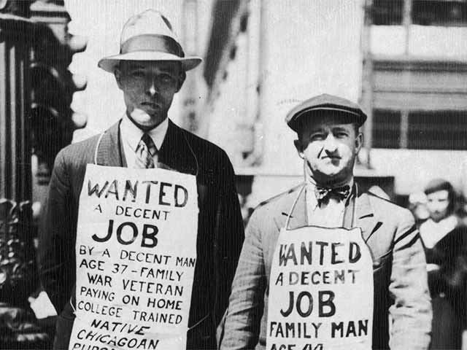
On Tuesday October 29, 1929, the stock market crashed – everyone had dumped their stocks
At first, no one realized how serious this problem would be – Even PM Mackenzie King thought that the economy would naturally correct itself

