Slide 1
Minds On – 3 and 3 Discuss
Based on what we’ve seen in the past week or so, what are 3 pieces of evidence the 20’s did ‘roar’?
What are 3 pieces that suggest the 20’s did not ‘roar’?

Slide 2
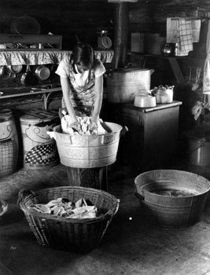
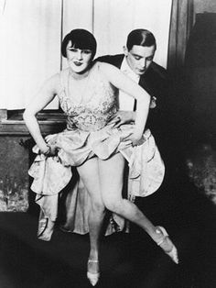
CSI Investigation – Quick Discuss
Look at the images on pg. 36. How does this reinforce the discussion we just had about the ‘roaring-ness’ of the 20’s?

Slide 3
Discrimination in the 1920s - CSI
Set up the same chart that you see in the During Reading on pg. 37.
Read through the chapter (the information and the primary evidence) and fill 3 things you want to remember, 2 things you want to know more about, and 1 thing that you think is most significant for each group of people.

Slide 4
First Nations
3
2
1

Slide 5
Chinese Immigrants
3
2
1

Slide 6
Workers
3
2
1

Slide 7
Black Canadians
3
2
1

Slide 8
Wrap Up – Test Ideas
Between issues at the home front and the 1920’s what are some inner conflicts we’ve seen in Canada?
What are several ways Canada developed its national identity during this period?

