Slide 1
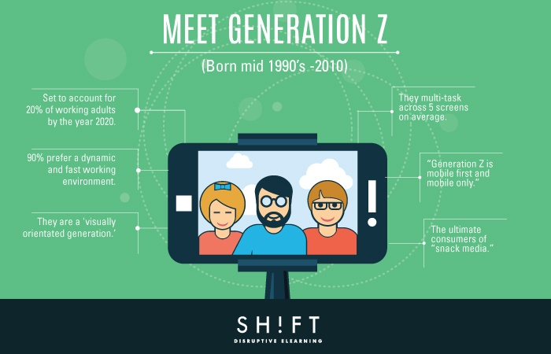
Minds On – Opening Clip
Click on the image to open up with a quick clip about how Gen Z is seen in the work place.
Afterwards have a quick discussion on what you agree/disagree with.

Slide 2
Article Discussion
Read the article “Support Gen Z” (I’ll get it back from you at end of class)
Make a list of suggestions the author makes to help Gen Z in the workplace
Put potential responses in the highlighted column. Remember that relationships and changes to society are key)
After, get with a group so that all three other generations are represented – discuss/compare/fill in your own chart

Slide 3
Which Gen Are You Really?
First, think to yourself whether or not you should belong to any other generation based on your worldview, values, etc.
With any time left get your phones and type in “Which Generation Are You Quiz” (there are tons).
Try a few different ones and see what you come up with. I did a few and got different answers depending on the quiz.

