Slide 1
Minds On – Generational Thinking
In your notes write the following (you can discuss with a partner)
Ways the post-WW2 era could be considered a success for those coming of age in the 50s and 60s
Ways the same time period was a challenging time

Slide 2
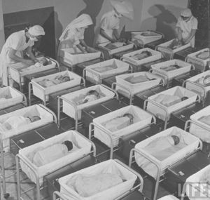
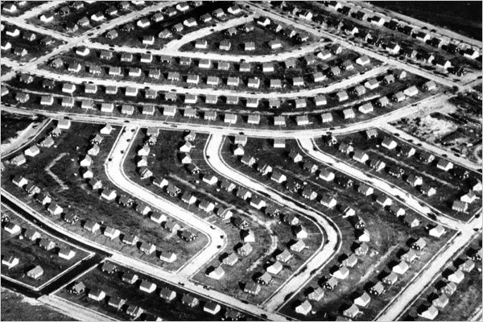
Stages of the Baby Boom
The Early Years
Generally regarded as those born in between 1946-1964
Post-war years were typically defined by success – Soldiers returned to a good economy and the “American dream”
In Canada over 8 million babies were born in these years
A huge need for infrastructure, residential space (the suburbs) and services were needed for growing families

Slide 3
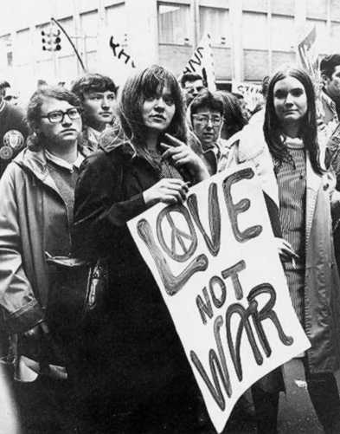
Coming of Age
The early boomers grew up in the turbulent 1960’s (civil rights, women’s movement, Vietnam)
They began rebelling against the conservatism of the 50’s and developed a counterculture – where a large part of society expresses values conflicting with society’s norms
Beyond the stereotypical “hippie” was a growing educated class, political activism and consumer

Slide 4
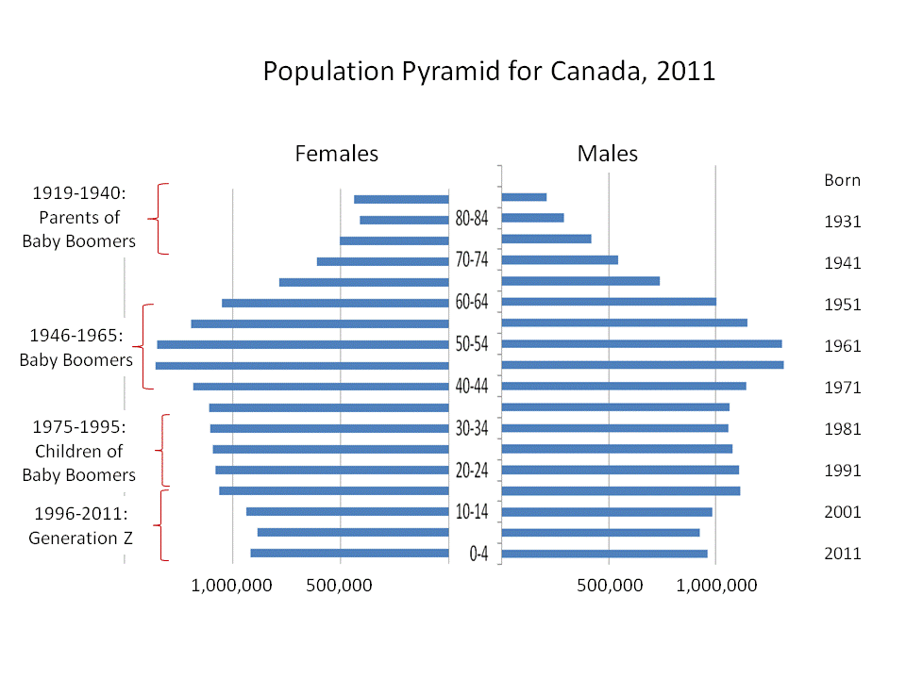
The Boomers Retire
The early boomers have begun to retire and the youngest are in their early/mid 50’s
This will have a massive impact on the economy in a number of ways, but difficult to predict
Jobs opening up for next Gens?
Boomers keep working?
Wealthy Boomers spend!!
Stress on pensions, healthcare, social services

Slide 5
Generation Theory – Possible Questions
Using the Baby Boomers, how can Mannheim’s idea of ‘fresh contact’ inform the ‘crisis’ needed for Strauss-Howe’s ‘turning’?
Based on this is it justified or an overstatement to call them the ‘prophet’?
Can the counter-culture of the 1960’s be considered rebels or retreatists?
Do you believe the mass retirement of the Boomers is a crisis for your generation?

Slide 6
Other Questions
Use the elements of a social group to define a group you are currently in.
How connected to IEW are you? Use the social bond theory to assess.
Think of a celebrity/public figure. Where are they on the deviance typology? Why?
Which theory of deviance do you feel best explains crime?
Which stage of the process of discrimination do you feel is most prominent in society?

