Slide 1
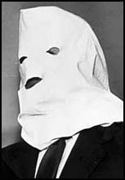
Minds On – Igor Gouzenko
What is espionage?
With the Gouzenko Affair it can be said the Cold War was sparked in Canada. What do you think?
Check this out!! (Video linked to picture)

Slide 2
Mind’s On – Why Would We?
First with the people closest to you and then as a class discuss why would we would want to do the following. Try to use specific examples based on other things we’ve learned about.
Promote world peace and human rights
Cooperate with the US on an international defence system
Form new economic agreements with the US
Increase foreign aid to less developed nations

Slide 3
Cold War Alliances

Slide 4
The United Nations
Founded in 1945 by 51 nations, now has almost 200 members
Aim is to keep peace in the world, maintain friendly relations and uphold human rights
Canada has participated in many UN peacekeeping missions
Video linked to picture

Slide 5
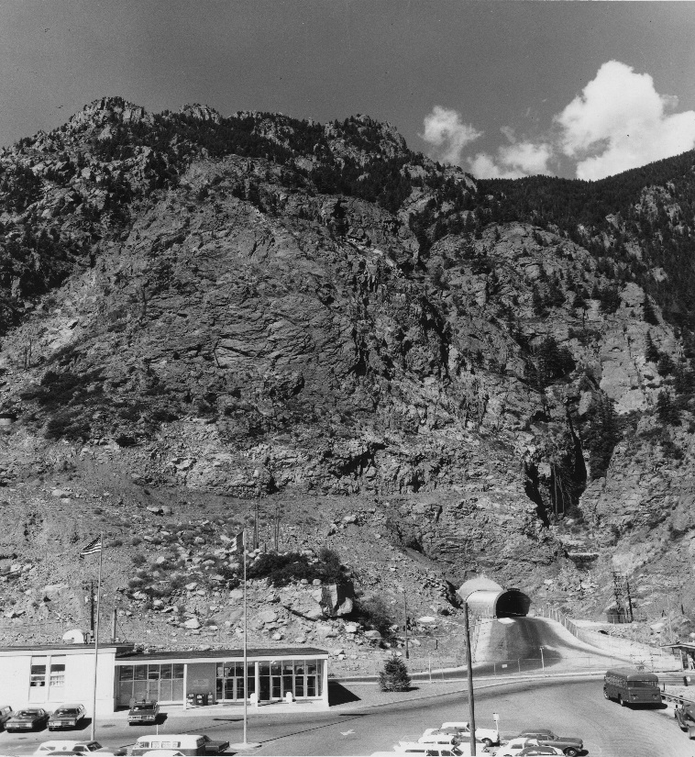
NORAD
North American Air (Aerospace) Defence Command
An alliance between Canada and US started in 1957 designed to prevent a Soviet attack
Based on radar lines built in our far north – The DEW (Distant Early Warning) Line
Video linked to picture

Slide 6
NATO
Canada was a founding member of NATO – the North Atlantic Treaty Organization
The goal was to keep peace in Europe, especially against Soviet Union
Created in 1949 and is still going today
Video linked to picture

Slide 7
Textbook – Topic Analysis
Read the Nuclear Threat and Canada’s Response chapter in CSI (142-147)
Choose 5 pieces of evidence and make a chart like the following:
Name of Source | Purpose | Does this suggest Canada was prepared? | What is the overall feeling?

