Slide 1
Minds On: Back In the Day
Set up a chart like the one below:
Once set up work through each section with Mr. Shields and then on your own or with a partner.
 | First Word | 1914 | Now
Technology
French/English Relations
Status of Women
International Relations
Canadian Identity

Slide 2
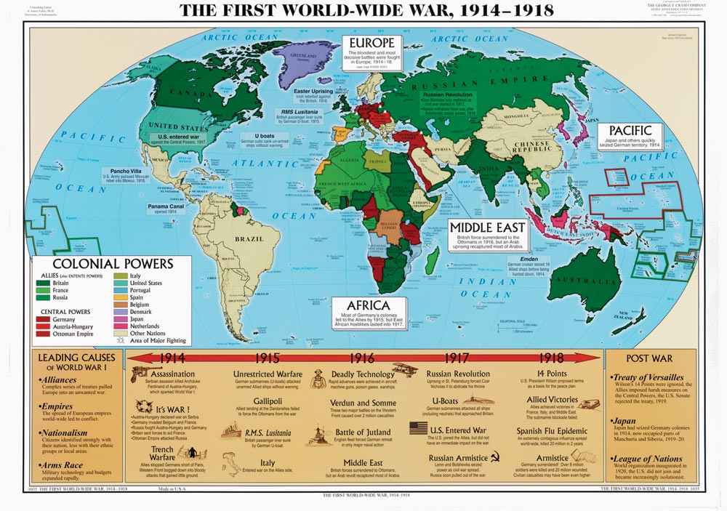
The World Before WW1
Big Questions:
#2,3
HTC:
Evidence

Slide 3
Canada in 1914
Population: 8 million
Prime Minister: Robert Borden (Conservative)
We had just signed Confederation in 1914 to make us our own country and step away from the British Empire.
French-English relations were often tense
The status of women was low
Although our economy was still resource-based we were becoming increasingly industrial

Slide 4
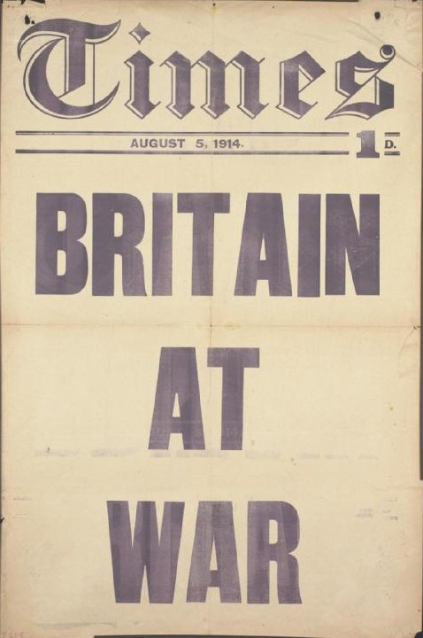
Europe in 1914
Britain:
Small in size but had lots of money and power
Had the most powerful navy in the world
KEY POINT – Had many colonies around the world (Canada, Australia, etc.)

Slide 5
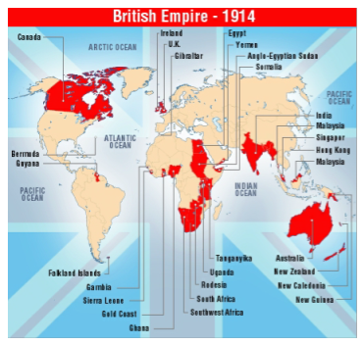

Slide 6
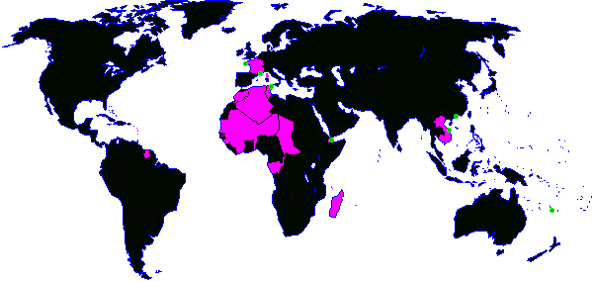
France
France:
At this time not as powerful as it used to be
Is in a central location in Europe
Also has colonies
KEY POINT – A mutual hate with Germany

Slide 7
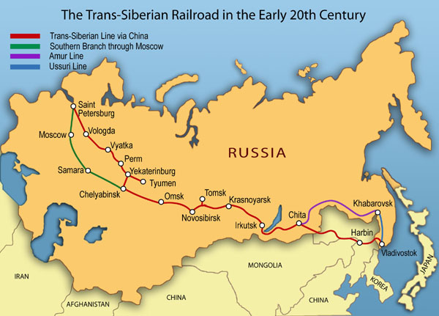
Russia:
The biggest country in the world in size
A very large population
Were very poor
KEY POINT – Large army, but very scattered

Slide 8
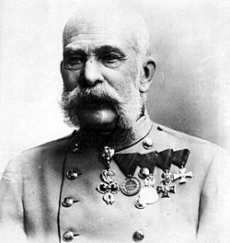
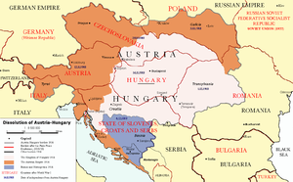
Austria-Hungary:
Many different cultures in one area
Was a political mess: Not very organized
KEY POINT: A weak and outdated empire

Slide 9
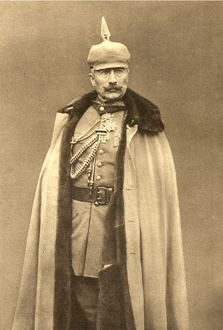
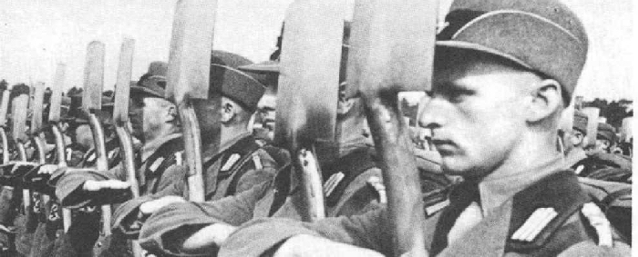
Germany:
A strong industrial nation
Also has a very strong army and navy
KEY POINT – Was power hungry and jealous of Britain

Slide 10
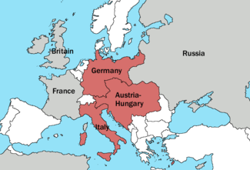
Video Clip: The Alliances of Europe - 1914

Slide 11
Activity: Who Is Ready for War?
Using the information booklets fill in the chart regarding national resources and afterwards write a response based on the following:
Who is most ready for war and what might the consequences of their entry be? Use specific details from the lesson and reading to support your answer.
Also consider the “Problems” paragraph for each nation before making a final decision!

Slide 12
Wrap Up – Paragraph Feedback
Trade paragraphs with the person sitting closest to you.
After reading their paragraph write down two things they did well and two things they could work on.
Hand paragraphs in to Mr. Shields so I can check them out as well!

