Slide 1
Mind’s On – Investigating Pictures
In your notes, make a chart like the one below.
I am going to put up 3 pictures. In your notes, write 2-3 details about the picture in.
After, describe how each picture makes you feel in the ‘Respond’ space.
 | Details | Respond
1.
2.
3.

Slide 2
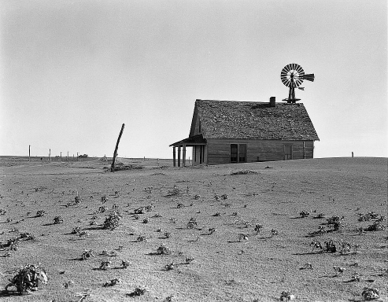
Picture 1

Slide 3
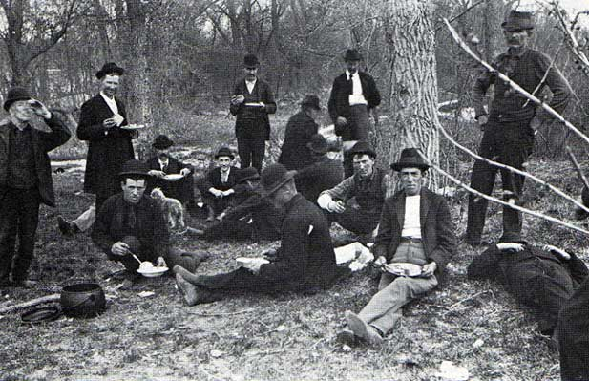
Picture 2

Slide 4
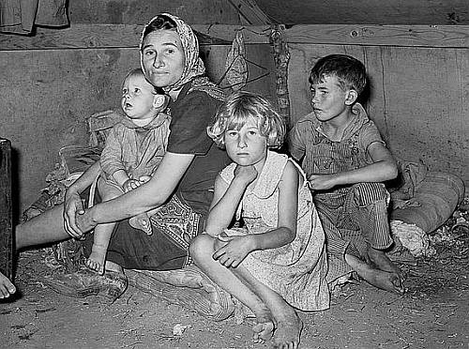
Picture 3

Slide 5
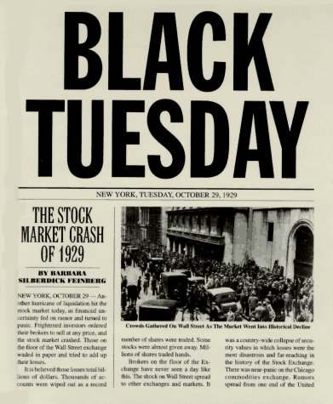
Social Conditions for Canadians
No unemployment insurance or welfare
2 million people were on Relief – Government assistance at the time

Slide 6
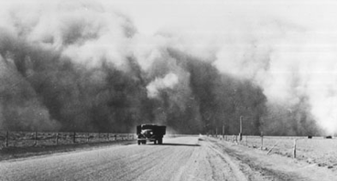
Areas Hit Hardest
The Maritimes were hit when other nations stopped buying fish and lumber
The Prairies were devastated by the dustbowl and a grasshopper epidemic

Slide 7
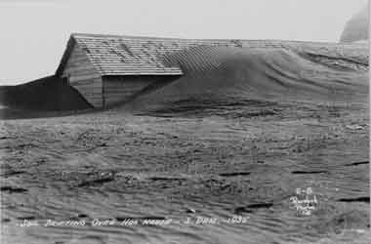
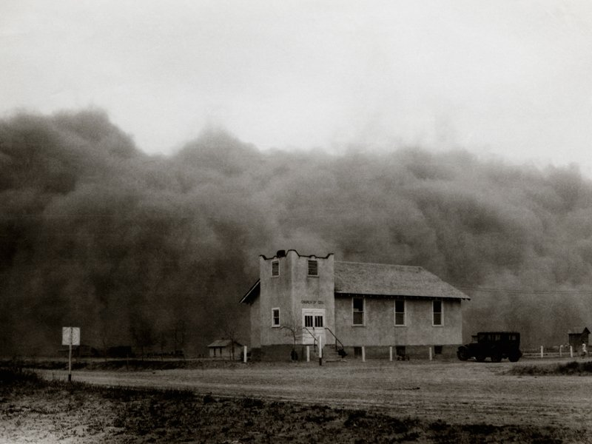
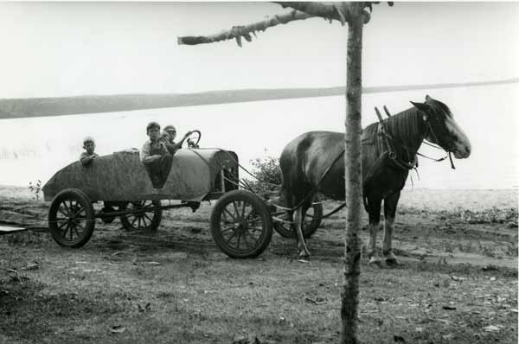

Slide 8
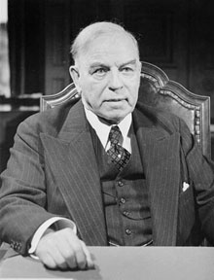
The Political Situation
Liberal PM Mackenzie King thought it was up to the provinces to aid their citizens
He stated that the federal government would not give “a five cent piece” to any province that had a Conservative government

Slide 9
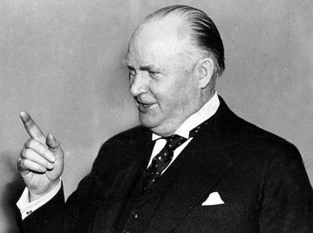
Enter RB Bennett
Bennett became PM in 1930
He was a self-made millionaire as a lawyer and businessman
He initially put $20 million towards emergency relief, but generally thought government intervention was not the solution

Slide 10
CSI Textbook
Grab a CSI book! On your own or with a partner assess at the Evidence in ‘Treatment of the Unemployed During the Depression’ using the worksheet provided.
The focus is on:
Historical Actors (Who is involved?) | Action (What is happening? What is this source telling us?) | Significance (Do you feel this source is significant? Why or why not?)

Slide 11
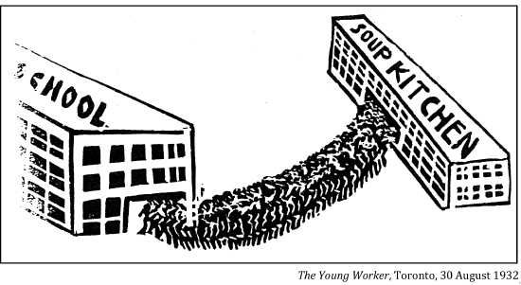

Slide 12
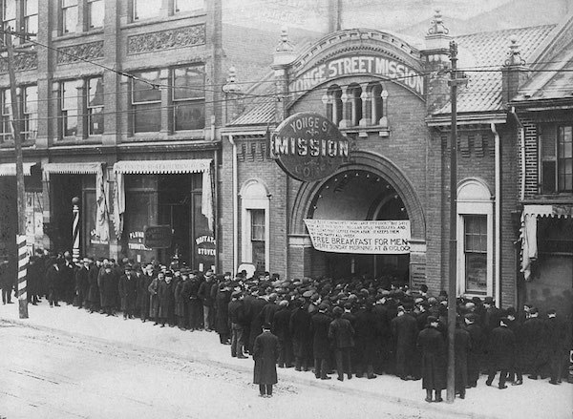

Slide 13
“I never so much as stole a dime, a loaf of bread, a gallon of gas, but in those days I was treated like a criminal. By the twist of some men’s minds, men in high places, it became a criminal act just to be poor, and this percolated down to the whole structure until it reached the town cop or the railway bull and if you were without a job, on the roads, wandering, you automatically became a criminal.”
In my search for employment I was free to range the whole commercial Winnipeg and nobody denied me a job from any ulterior motive. This did not hold for the Ukrainians, Poles, and Jews. For them, Winnipeg was far from being a city of 250 000 in which they too were free to search fro work. As much as two-thirds of it was barred and bolted against them.”

Slide 14
“With respect to giving moneys out of the federal treasury to any Tory government in this country for these alleged unemployment purposes, with these governments situated as they are today, with policies diametrically opposed to those of the government, I would not give them a “five-cent piece.”
May I conclude what I have to say? So far as giving money from the federal treasury to provincial governments is concerned in reaction to their question of unemployment, I would be prepared to go to a certain length possibly in meeting one or more of the western provinces that have Progressive premiers at the head of their governments…but I would not give a single cent to any Tory government on earth.”

Slide 15
“It was 1930 and King was in power… the Tories were hollering for some sort of relief to provinces for the unemployment that was building up… It wasn’t really a speech but an exchange in the Commons. RB Bennett, the Tory, was hollering for some benefits, some money for the needy, the starving. King’s battle plan was that the government should spend money to stimulate employment and not just put out money to feed and house those already unemployed. It was what you could call a confrontation of Depression philosophy. No direct financial assistance, that was King’s point.”

