Slide 1
Monday Minds On: Quick Review
What is a ritual?
Why are rituals important to pre-literate religions?
What are ways some cultures showed respect to their gods?
What was the Wicker Man?

Slide 2
What Do You Know?
Tell me everything you know (or think you know) about Ancient Greece.

Slide 3
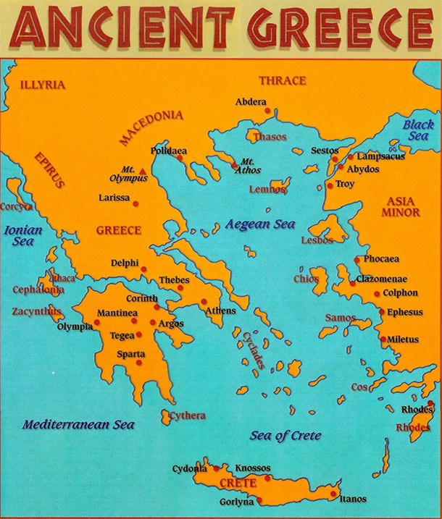
Ancient Greece: Background

Slide 4
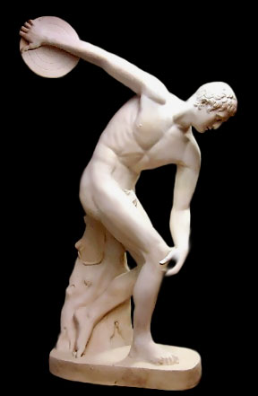
Like the Roman Empire, started as many city-states.
Among the most powerful were Athens, Corinth and Sparta
The landowners were the most powerful and trade, banking, and art were key elements of life

Slide 5
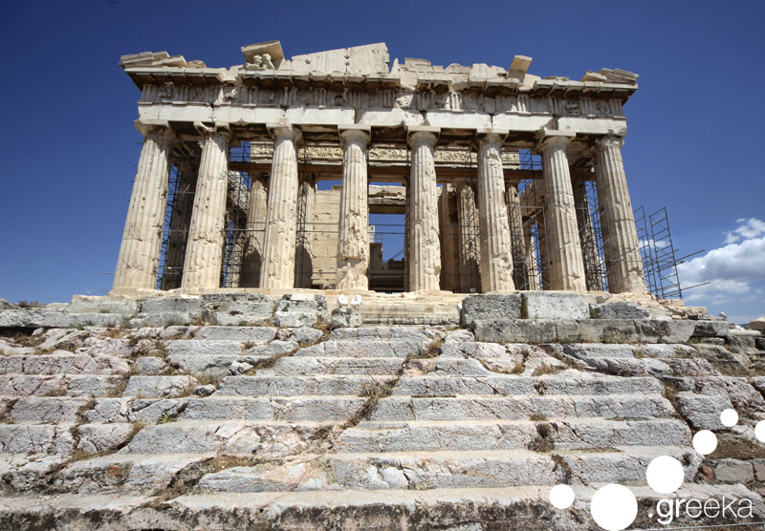
Athens became a center of power and philosophy
It was also a place of luxury, with beautiful statues and monuments (the Parthenon, which was a statue to the goddess Athena)
Socrates, Plato and Aristotle questioned the world around them and were important teachers

Slide 6
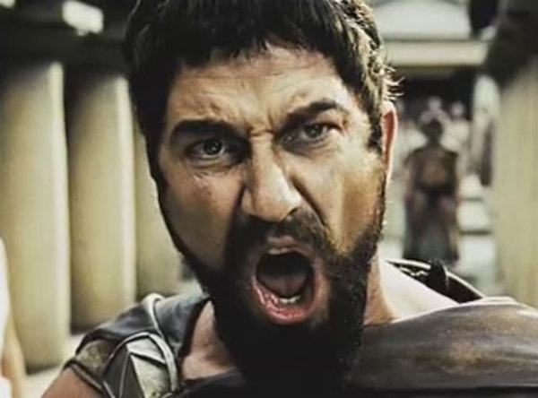
Sparta was a much different city, and was more violent and war-like
Boys as young as 7 began training for military service
They did not celebrate the arts or ideas like Athens

Slide 7
Textbook Time
Get the World History textbooks (different than the normal ones) and answer the questions about the Persian War (Q 1-6) on the questions sheet given to you.

Slide 8
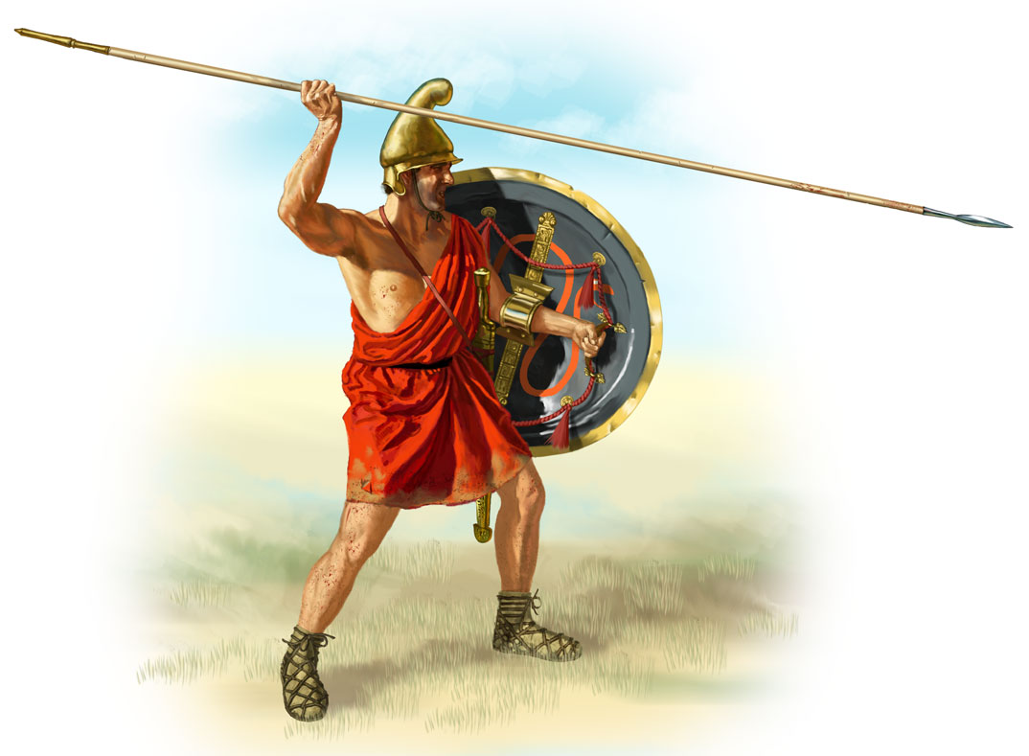
Foot Soldier Video
Watch the video linked to the picture below and try to answer the questions as you go. I know its goes fast but we’ll take them up!

Slide 9
Tuesday Minds On: Quick Questions
What was the difference between Athens and Sparta?
Based on your text questions, what happened at Marathon?
Based on the video, describe life for a Greek “Foot Soldier”

Slide 10
Textbook Time
Get the World History textbooks (different than the normal ones) and finish the questions on the worksheet.

Slide 11
Finish the Foot Soldier Video
Hopefully the previous teacher made note of what time you were at! Follow along with the remaining questions as best you can.

