Slide 1
Historical Thinking Activity: Cause and Consequence
Follow the steps to fill out the your Cause and Consequence sheet
Step 1 – Easy! In the chart under the first arrow write down where you are in the PRESENT
Step 2 – In the chart under the second arrow write down the RESULT, meaning, what is likely to happen next.
Step 3 – In the chart under the third arrow write down probable CONSEQUENCES of you being here and then moving to the next step.
Step 4 – This is the fun part – What are some possible alternatives that MIGHT CHANGE THAT CONSEQUENCE? Write down reasonable possibilities only in the final box.

Slide 2
Historical Thinking Concept: Cause and Consequence
Change is driven by multiple causes and can result in multiple consequences. These causes and consequences can be short term or long term
The causes that lead to a particular historical event can vary in influence, with some being more important than others
Events result from different types of factors: 1) Historical Actors – Individuals or groups who take action that cause events and 2) The conditions (social, political, economic, cultural) within which the actors operate
Historical actors cannot always predict the effect of conditions, opposing actions, and unforeseen reactions. These are unintended consequences.
The events of history were not inevitable, any more than those of the future are. Alter a single action or condition and any given event might have turned out differently.

Slide 3
Mind’s On – Quick Discuss
Chat with your partner/group for 1 minute about what could start a potential war (past, present, future)
Discuss briefly as a class

Slide 4
The Causes of WW1
Big Question: #3
HTC: Cause and Consequence, Using Sources

Slide 5
Textbook Investigation
Using the textbook Creating Canada, page pg. 174/175 to fill in the first 4 sections of your MANIA chart
Where the letter is just write in the word! (ie: Militarism)
For Cause Explained define it based on what that paragraph says
For Possible Consequence write in what you think might happen! Think of it in terms of this:
Militarism was a cause that could possibly lead to…

Slide 6
Militarism
The belief that the army and navy can make/influence political decisions.
Prepare for war to keep the peace. (Arms Race)
This was also vital to the economies of most European nations at the time

Slide 7
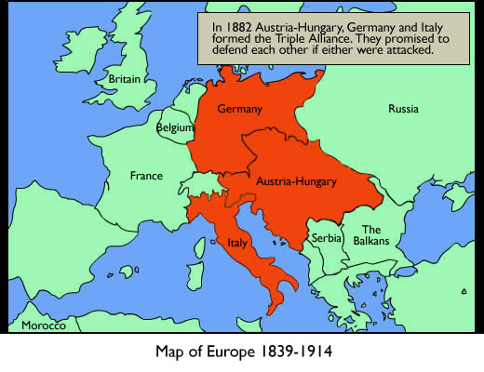
Alliances
Triple Entente – France, Russia, Britain.
Triple Alliance – Austria-Hungary, Germany, Italy
Italy leaves at the outset of war as their role in the Alliance was based on it being for defensive support
Countries set up agreements to support each other in case of war.

Slide 8
Nationalism
Patriotic feelings or pride in your country.
This can create intense feelings that can sometimes have negative results.
In this case patriotism was very strong in Germany, and there was a confused sense of nationalism in A-H (different cultures)

Slide 9
Imperialism
Countries have many colonies in other parts of the world.
This reflects military and political control. (Also gives them resources, etc.)
The major powers of Europe were based on empires – A different form of government that what we know

Slide 10
Minds On – Who’s MANI?
Quick review (WITHOUT NOTES!) of the first 4 causes of war

Slide 11
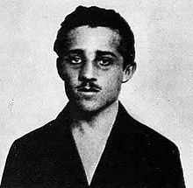
Assassination
“The shot that started the war.”
The Archduke Franz Ferdinand was killed by a group called the “Black Hand” (shot by Gavrilo Princip)
This introduces modern terrorism
This was the spark started the steps to war, but was not the sole cause of the war

Slide 12
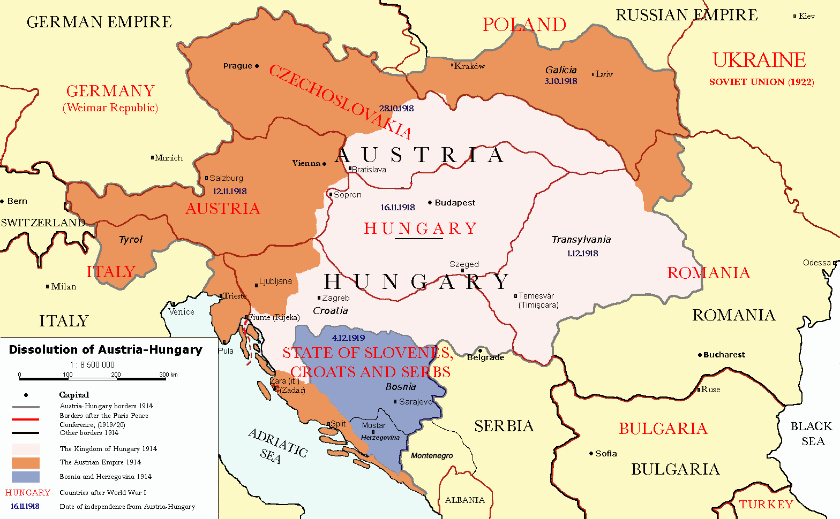
Cause and Consequence – Counter Factuals
Remember that in Cause and Consequence the possibility of unintended consequences is significant
Brainstorm some ideas answering this question: What results could Gavrilo have reasonably expected from shooting the Archduke?

Slide 13
Quick Vote – Which Cause?
Quick show of hands! Which do you think was the primary cause of WW1?
M
A
N
I
A

Slide 14
The Steps to WW1: The Domino Effect Use the ‘Connections’ on pg. 175 to fill in the chart you have been given

Slide 15
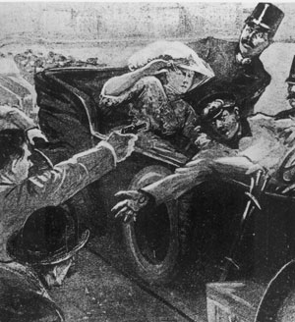
June 28
“The spark” – The assassination of Archduke Franz Ferdinand by Serbian Nationalists the Black Hand in Sarajevo

Slide 16
July 23
Austria sends ultimatum (list of demands) to Serbia
The demands were for Serbia to put down nationalist hatred toward Austria-Hungary and to punish the assassins
Also on the list was to allow Austria-Hungary into Serbia to crush the Black Hand

Slide 17
July 28
A-H declares war on Serbia and invades them

Slide 18
July 29 – August 1
Russia pledges to support Serbia
They begin to mobilize their army along the Austrian and German borders
Germany replies, declares war on Russia

Slide 19
August 3
France pledges to support Russia
Mobilizes their army against Germany
Germany declares war on France

Slide 20
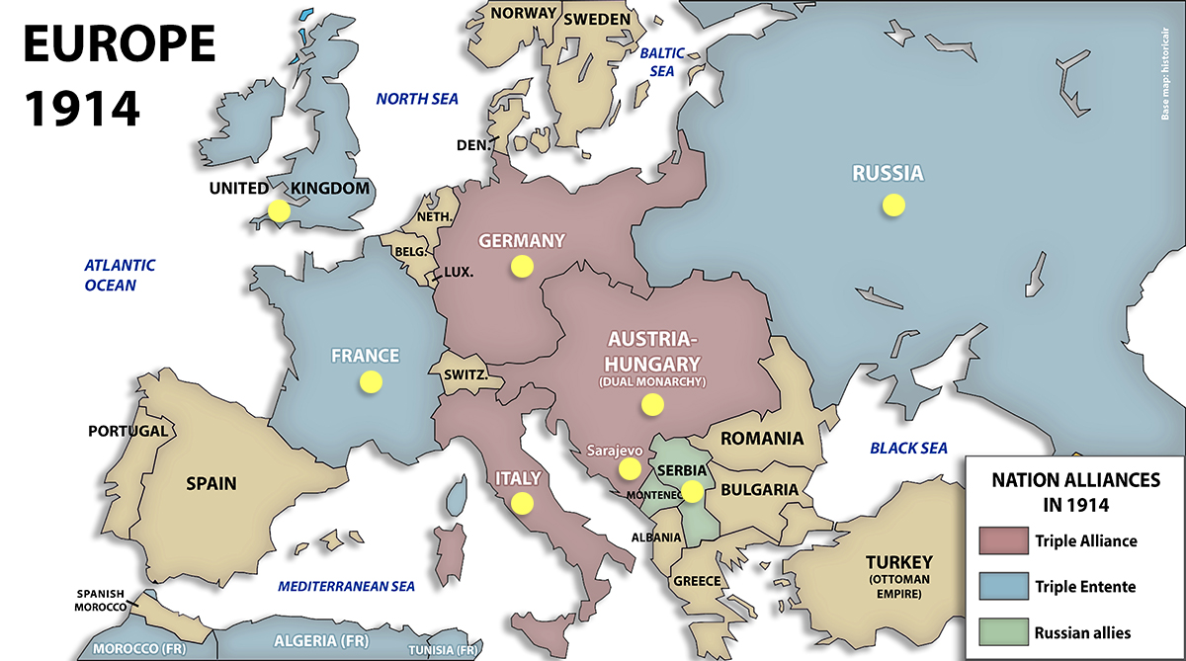
QUICK DISCUSS: WHAT DO YOU DO IF YOU ARE GERMANY?

Slide 21
August 4 – 5
Germany uses the Schlieffen Plan to invade France, invading Belgium along the way
The goal is to take out France and quickly turn around to face Russia to avoid a two-front war
Britain pledges to support Belgium and declares war on Germany
As part of the British empire Canada goes to war to support Britain

Slide 22
Failure of the Schlieffen Plan
The Belgian army resisted
The British mobilized quickly
The Russians mobilized in just 10 days and Germany was forced to withdraw troops to defend the east
The Germans did not complete their full swing to the west and attempted to move on Paris much earlier
They were then met by the French and both sides began to ‘dig in’
BIG IDEA: The failure of the Schlieffen Plan defined the nature of WWI – Trench Warfare!

Slide 23
Using Evidence – Cartoon Review
Does the cartoon extend what I know from the chart? Explain.
Does this source take away from or challenge what I already know?
What limitations does this cartoon have as a historical source?

Slide 24
Taking The Evidence Further
As the start of WW1 was just over 100 years ago there is more information than ever about it
For years historians have been asking one simple question: Who started WW1?
In this activity you and a small group will given the perspective of a noted historian regarding the start of WW1 and you will analyze that source according to the following:
1st! Who do YOU think is responsible?
Who does this reading say is responsible and why?
How does your thinking change after reading this source?
What might this source not tell us?

