Slide 1
Mind’s On – Hail to the Chief!
Your group are important members of PM Bennett’s inner circle and need to come up with solutions to getting out of the Great Depression, and fast.
Make a list of ideas
Switch sheets with another group and now comment on how those ideas might happen, how are they realistic/unrealistic, how will Canadians respond to those ideas, etc.
Put them on the board!

Slide 2
New political parties: solutions to the great depression?

Slide 3
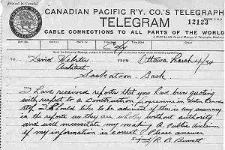
Bennett’s New Deal
A new plan by Bennett introduced just before the 1935 election
Modeled after the US New Deal designed to jumpstart the economy
Was seen as too little, too late → Consequence was he was voted out

Slide 4
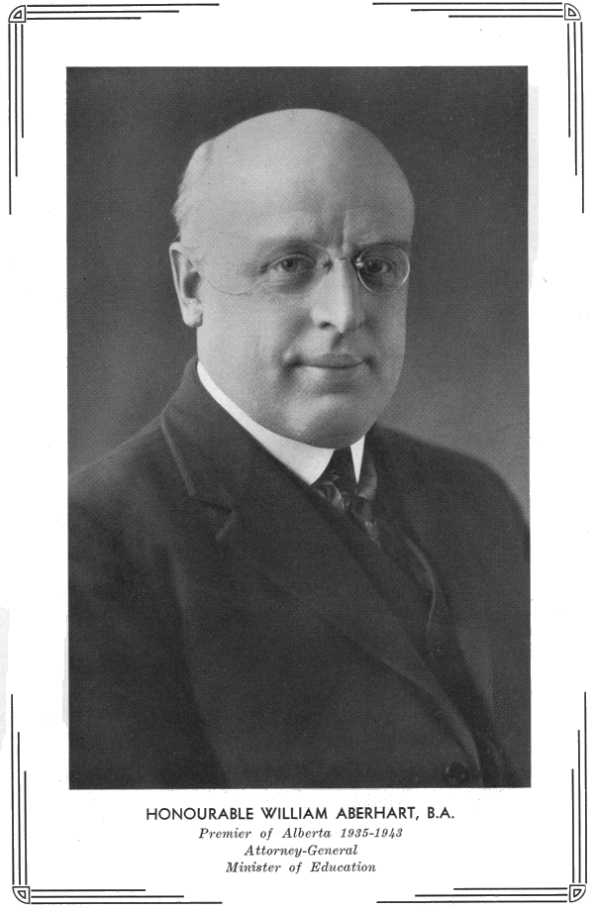
The Social Credit Party
As a response to federal and provincial failures, new regionally based parties began
The Social Credit Party took power in Alberta in 1935
Led by William “Bible Bill” Aberhart

Slide 5
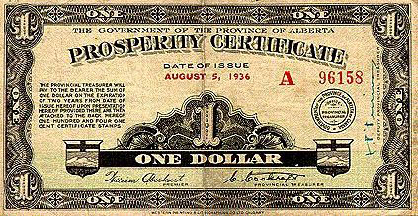
His theory to ending the Depression was to give all Albertans $25, this would stimulate economy
Make a small Positive/Negative t-chart under this point – What are some point for each side of this proposed solution?
Positive | Negative

Slide 6
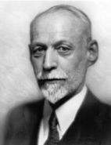
Co-operative Commonwealth Federation (CCF)
Formed in 1932 by a mixture of farmers, teachers, MP’s, labour groups, etc. This group was largely inspired by socialism
Led by James Woodsworth, who was arrested for being part of the Winnipeg General Strike

Slide 7
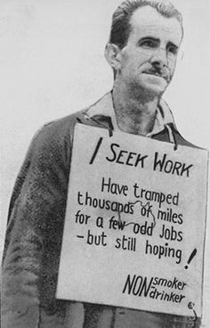
First proposed the idea of the ‘welfare state’, which means that society should protect citizens from extreme hard times
Was renamed the New Democratic Party (NDP) in 1961, now one of the major Canadian parties

Slide 8
Wrap up – Vote and Post
On a Post It, write down who you would vote for to try and get out of the Depression: Aberhart, Woodsworth or Bennett
Give 2 reasons why you’re voting for them!
Also write down who you definitely would not vote for and provide a reason for that too!

