Slide 1
Minds On – Can You Handle It?
No because I don’t want trench foot or shell shock
I would not like it but I could do it
No I like to have showers and clean clothes
No because I’m not very tough
It would be too drastic a change from normal life
I couldn’t because of how lazy and weak I am

Slide 2
I would not last a day.
I would go crazy from constant, never-ending fear.
I like my feet the way they are.
I could not handle seeing loved ones pass away right in front of me.
I love peace and don’t like loud noises.
I am too intertwined with technology to leave it behind.
I don’t think I’m built for that lifestyle.
No. I have a nervous breakdown doing a math question.
If I were there I might actually want to die.

Slide 3
Video Clip – The Trenches

Slide 4
Canada’s Early Battles
Focus:
I can assess the historical significance of several of Canada’s key contributions to WW1.

Slide 5
Ypres – The Basics
Where: Outside the town of Ypres, Belgium
When: April 22-24, 1915
Notable Because:
This was Canada’s first significant engagement
It was the introduction of chemical warfare (mustard gas)

Slide 6
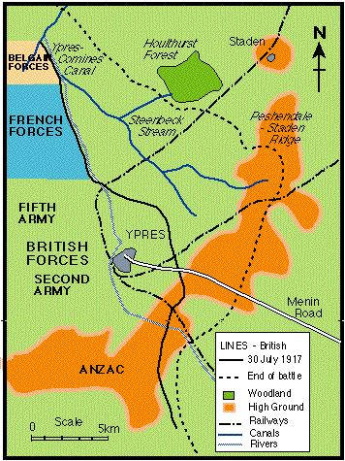
Canada’s Role:
We held off the Germans after the French retreat
We developed a temporary solution to the gas
Legacy: The Battle of Ypres is where Canada built our reputation

Slide 9
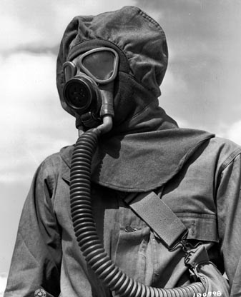

Slide 12
In Flanders Fields
Most known for its role in Remembrance Day ceremonies
Written by Canadian soldier/medic John McRae in response to seeing the horrors of the Battle of Ypres

Slide 13
The Somme – The Basics
Where: The Somme region of northern France
When: July 1 – Nov 18 1916
Notable Because:
This was an Allied attempt to end the war
We were following the antiquated orders of British General Douglas Haig
This was the first large-scale introduction of the tank (new tech)
On the first day casualties were over 57,000
Over 1 million lives were lost by the end of the battle

Slide 14
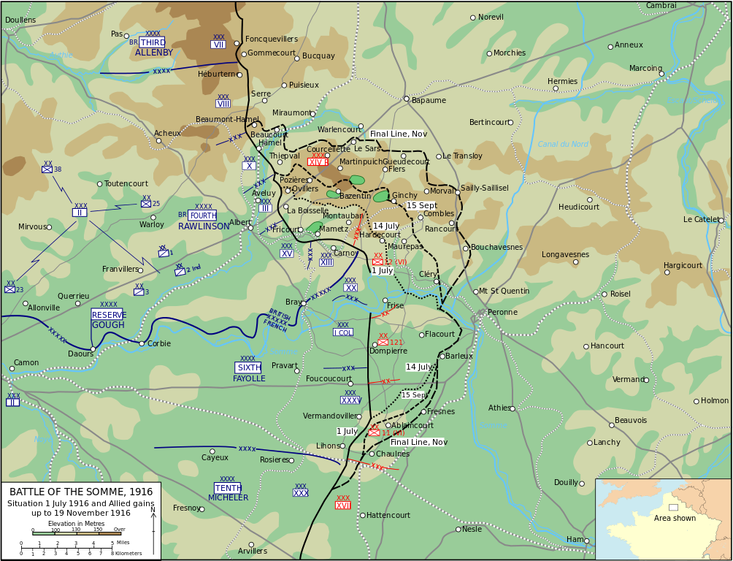
Canada’s Role: The Newfoundland Regiment was decimated at Beaumont-Hamel the very first day
Legacy: After this battle we began to take ownership of our own leadership

Slide 15
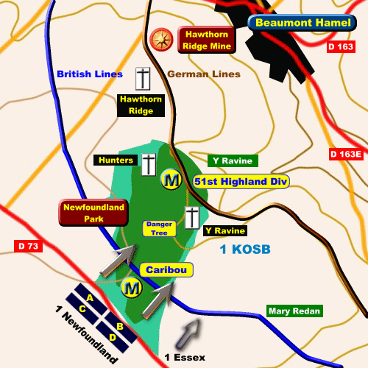

Slide 16
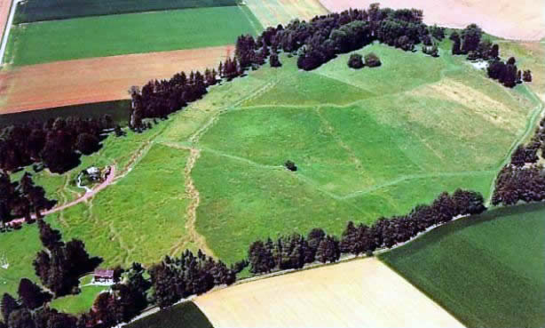

Slide 17
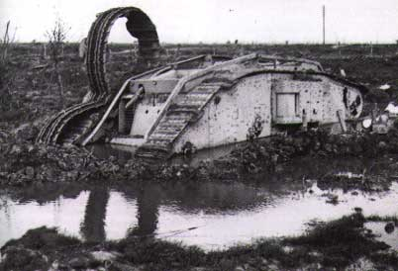

Slide 18
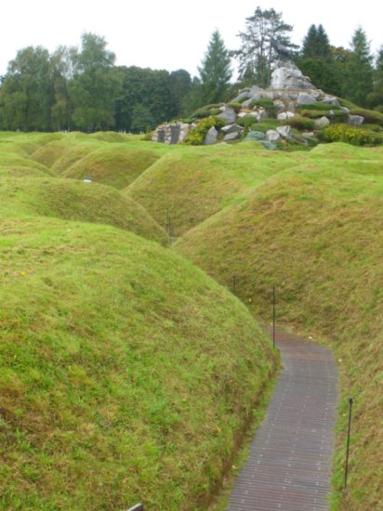
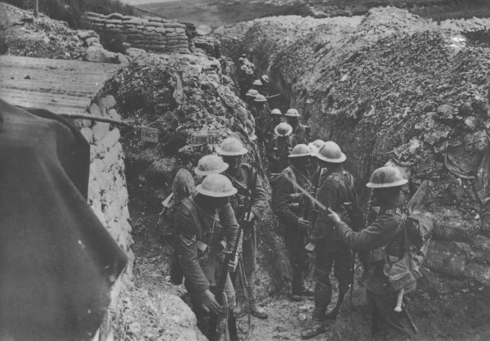

Slide 19
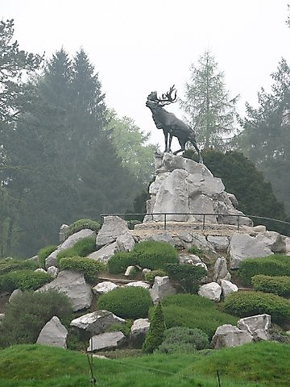
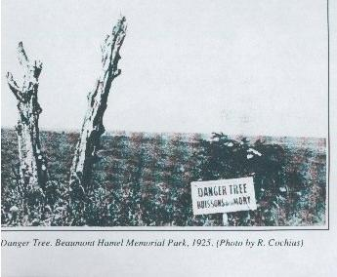
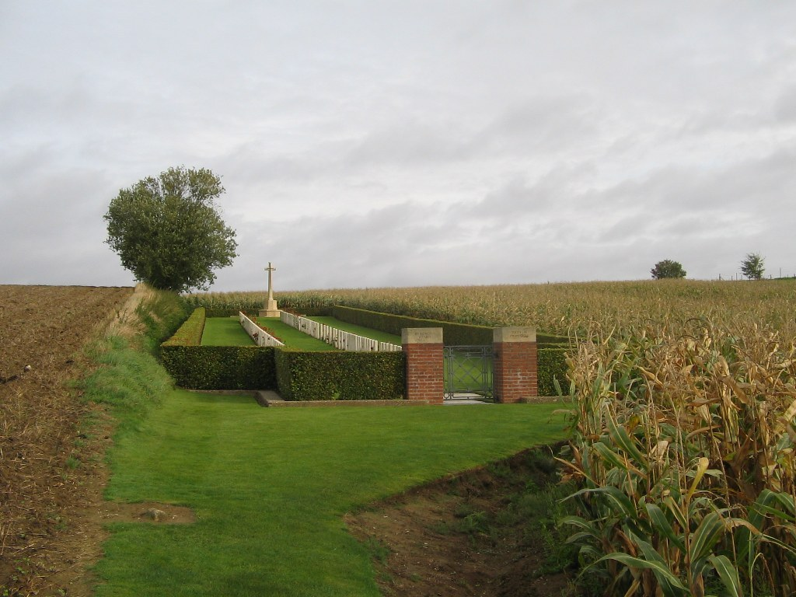

Slide 20
Literacy Prep Task
Half of you will focus on the Battle of Ypres, the other half will use the Battle of the Somme (including Beaumont Hamel)
Based on today’s lesson you will write a paragraph answering the the following Open Response question:
Was Canada successful in this battle? Use specific details from the lesson to support your answer.
After you have written your paragraph compare with a person who had the opposite battle

