Slide 1
Minds On: Historical Perspective Quick Discuss
Britain declared war on Germany Sept. 3, 1939. With the person closest to you discuss how each of the following people would feel upon hearing that news:
A young Canadian man
A Canadian mother of a young man
A Canadian father of a young man who fought in WW1

Slide 2
Canada Goes To War

Slide 3
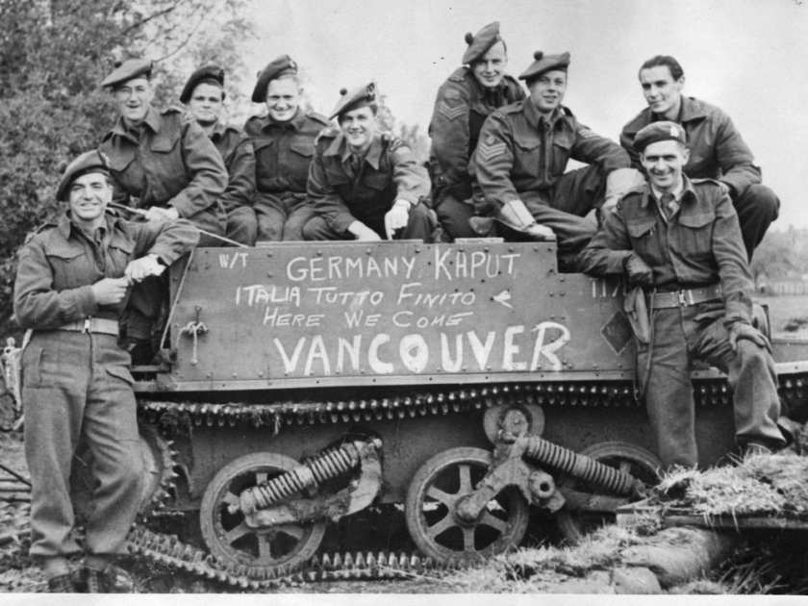
Unlike WW1, Canada was able to make its own decision to enter WW2
PM Mackenzie King officially declared war on Sept. 10 1939, a full week after Britain/France declared (Sept. 3)
Quick Think! Write a reason why Canada waited a full week and explain why you think that was a good/bad idea

Slide 4
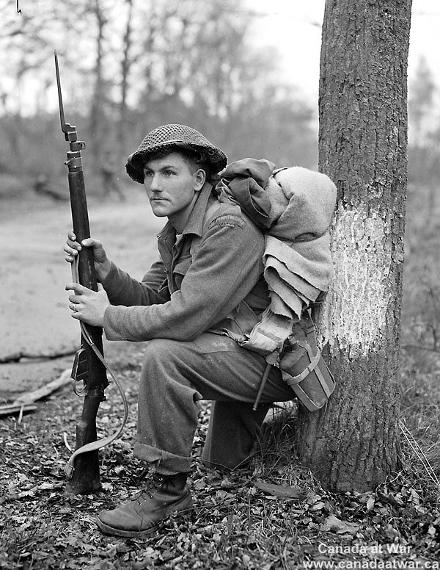
At the beginning of World War II our population was about 10 million, and there were only 10,000 members of the Canadian armed forces.
By the end of September, Canada had over 58,000 people enlist
Many of these recruits were unemployed men hoping for an end to the Depression.
Millions of other Canadians contributed to the war effort by working in war factories, mines, forests and farms.

Slide 5
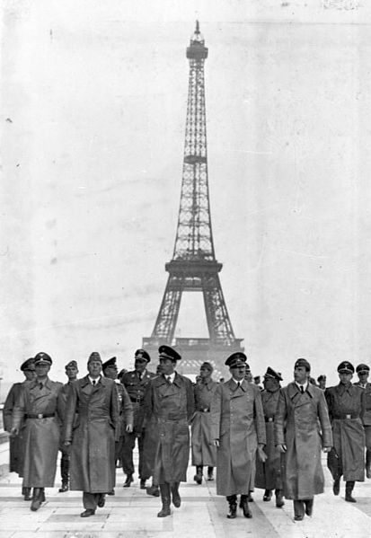
Documentary: The Gathering Storm
Write down the title of the doc and make the chart you see below. As you watch makes notes for discussion and write down any questions you have. Video linked to picture.
Evidence of Germany breaking the Treaty of Vers. | Notes on German expansion in Europe (especially Belgium and France) | Notes on preparation from the Allies (Britain, France, US, Canada)

