Slide 1
Mind’s On – Picture Analysis
How many pictures do you take a day? What do you do with them?
How many of those will you look at or consider important tomorrow? Next week? Next year?
Why do historians consider photographs important pieces of evidence? What problems might they present?
On the following slide you will be shown an image. As a class we will work through ‘What Do You See?’ and then discuss some specific ‘Inferences’

Slide 2
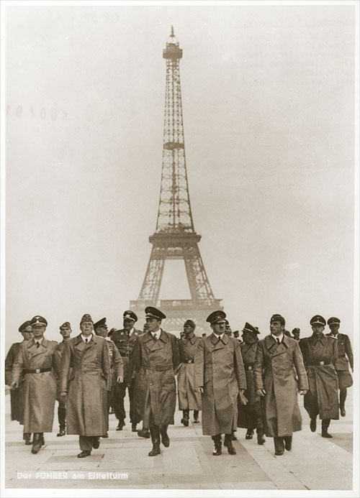
What Do You See?
What can we infer about this
particular group of Nazis?
Based on what you know, what stage of the war might this be?
Why do you think the location of
this photo is important?
What do you think is happening elsewhere in Europe?

Slide 3
Canada’s Early Role in WW2

Slide 4
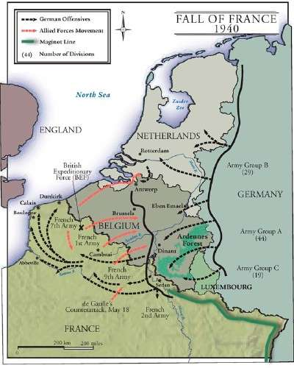
1939/40 – Canada mobilizes with great support, arrive in England for continued training
1940 – Germany sweeps through western Europe with occupation of France in June. The French government goes into exile.
1940 onward – Germany begins building up defences on ‘Atlantic Wall’ or ‘Fortress Europe’ (coast of France)

Slide 5
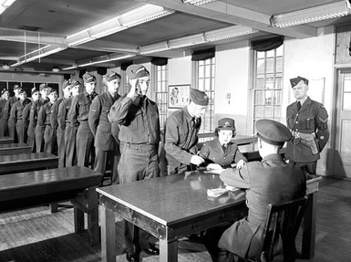
As Hitler continued occupying Europe through 1940 the Allies were rebuilding. This is often called “the Phony War” as war was declared but we weren’t actually fighting
Canada once again began supplying the Allies with munitions, food and other supplies. This had a huge impact on the home front and reintroduced the concept of Total War

Slide 6
Creating Canada – Battle Charts
Step 1: Make THREE charts like the one below. Label each 1) Battle of Britain, 2) Hong Kong and 3)Dieppe
Step 2: Get the Creating Canada textbook and go to pg. 289-291
Summary (Who, When, Where) | Canada’s Role (What did we do?) | Legacy (What is the legacy/memory of Canada’s role?

Slide 7
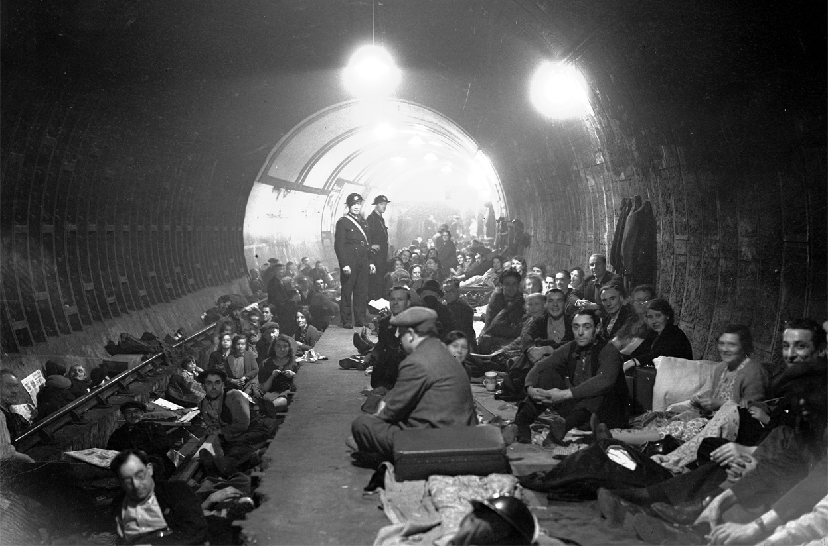
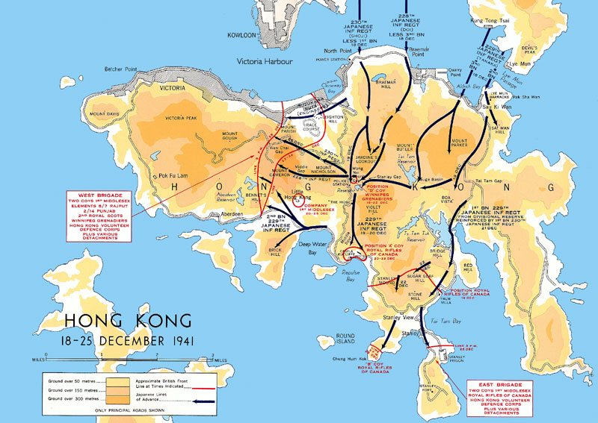
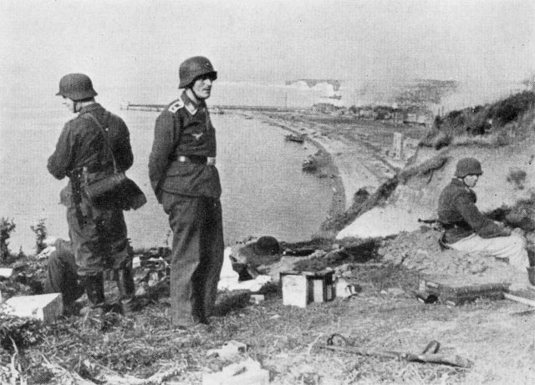
Step 3: Read the sections on Battle of Britain/Hong Kong/Dieppe and fill in points according to the chart

Slide 8
Battle of Britain 1940
From June-Aug The German Luftwaffe bombed various strategic and citizen sites nightly in hopes of the British surrendering
Canadian contribution included training and providing pilots as well as providing aircraft
The British citizens took cover in the Underground each night and then worked to rebuild each day
The British did not surrender – This can be considered the first time Hitler failed

Slide 9
Hong Kong – Dec 1941
The Canadians were part of a force defending the British colony of Hong Kong against Japanese threat
Occurred Dec 8, the day after the attack on Pearl Harbour
The Canadians were unprepared and surrendered quickly despite fighting valiantly (Dec 25)
They endured horrible conditions in POW camps for the remainder of the war

Slide 10
Dieppe – Aug 1942
The first Allied attempt at infiltrating “Fortress Europe” – A surprise attack on Dieppe, a German-occupied town on the NW coast of France
Led by approx. 5000 Canadians, this was considered a disaster
Over half were killed or taken prisoner
This has left a sad legacy, but many say the lessons learned led to the success at D-Day
It has recently been revealed that the Dieppe invasion could also have been a secret mission to obtain German spy equipment

Slide 11
Wrap Up: Rate the Significance
Underneath each chart rate Canada’s significance in that event from 1-10 (10 being high involvement)
After you rate our involvement give a statement for each to justify your rating

