Slide 1
Behavioral Study of Teens: An Unhealthy Generation? Policy Brief for I.E. Weldon
Executive Summary:
Recent trends on physical activity, eating habits and sedentary behavior at I. E Weldon all point to patterns that may be potentially damaging for long-term health. Furthermore, there is great concern that teenagers are unaware of these long-term impacts.
This paper outlines statistics directly connected to I.E. Weldon and provides potential policy changes that will make students aware of these issues and potential strategies to improve upon these behaviors.

Slide 2
Introduction
It is no secret there are more distractions for teenagers than ever before. With those distractions a variety of impacts – both positive and negative – are apparent and unique for Generation Z. This is of vital concern for present and long-term health.
This is a societal issue, but we can’t rely on the ‘big picture’ of society to solve it. Local action is the most efficient method of addressing the issues of physical activity, eating habits and sedentary behavior. As such, the Trillium Lakelands District School Board (TLDSB) has a responsibility to act on behalf of today’s students and those of future generations.
The main causes of unhealthy behaviors at I.E. Weldon to be addressed are as follows:
Causes | Effects
Lack of Physical Activity Poor Eating Habits Sedentary Behavior | Higher rates of obesity Increased ‘screen time’ Mental health and self esteem issues Decline in sense of community

Slide 3
Approaches
The main research is from the annual COMPASS survey conducted at I.E. Weldon
All findings is this Policy Brief are based on the 2015 COMPASS study unless otherwise noted
What Is the COMPASS Survey?
Compass is a 4-year study about youth health behaviours funded by the Canadian Institutes of Health Research. It is being conducted and lead by researchers at the University of Waterloo in collaboration with researchers at the University of Alberta and the University of Toronto.
Participating students in grades 9-12 will be surveyed once annually for 3 or 4 years.
Compass will also track any changes made to the school's health policies and programs during this time.

Slide 4
Results Key Findings at I.E. Weldon
Overview:
Much of what is seen at I.E. Weldon is either reflective or below national averages and recommendations. Downward trends in these statistics also reflect similar national declines since 2005 (Active Healthy Kids Canada, 2012). Although these statistics are indicative of national issues, local solutions will be the most the most effective in implementing changes for students within TLDSB.
Physical Activity
54% are enrolled in a PE Class this year
10% usually walk or ride a bike to school
36% involved with extracurricular activities
50% report strength training 3 times/week
46% are meeting national guidelines of at least 60 min of physical activity/day

Slide 5
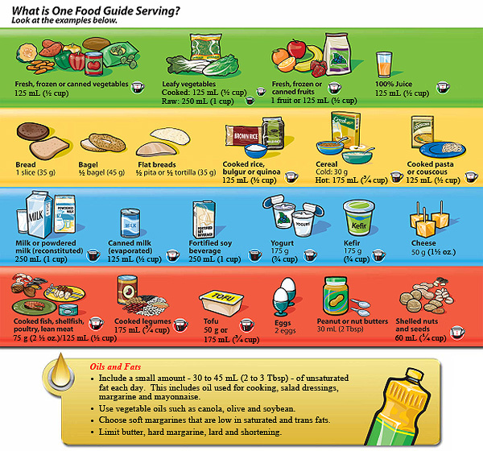
Eating Habits
63% report eating recommended 2-3 servings of meat or alternatives/day
45% consume recommended 4-5 servings of dairy
7% consume recommended 7-8 servings of fruit/vegetables
3% eating the recommended servings of all 4 food groups
45% of students buy their lunch from school once a week

Slide 6
Sedentary Behavior
Note: The national recommended amount of screen time per day is 2 hrs or less
Averages at I.E. Weldon:
Surfing the Internet: 1.5 hrs
Watching/streaming movies/TV shows: 1.7 hrs
Using phone for talk/text/email: 1.7 hrs
Playing video/computer games:1.1 hrs
The AVERAGE screen time among I.E. Weldon students is 6 hrs/day
ONLY 6% meet national guidelines of under 2 hrs screen time per day
Nationally, children and youth average 7 hrs and 48 minutes of screen time per day and 19% report being under the 2 hrs/day recommendation (Active Healthy Kids Canada)

Slide 7
Conclusion
Physical Activity
It is clear that not enough students are engaged in physical activity on a consistent basis
That IE Weldon is a rural school where bussing is the primary means of transportation explains the low number of walkers/bike riders – They need to be more engaged both here and on their own
“Organized play” by means of Phys. Ed class and extra-curriculars is prevalent, but it is unknown how much “free play” takes place
Eating Habits
The statistics speak for them themselves – students at Weldon are not eating well enough!
Fruits and vegetables are a particular weakness, leading to the overall 3% of students satisfying all 4 food groups

Slide 8
Sedentary Behavior
Cumulative screen time is a significant issue – It appears that students are simply going from one screen to another or perhaps using multiple screens at the same time
It is a very strong possibility that a) students don’t know about the maximum recommended screen time or b) openly choose to ignore it
This suggests that immediate social concerns are more pressing health concerns, both present and long term

Slide 9
Implications
Physical Activity
Students not on school teams might see a lack of opportunity in physical activity
Students might not see healthy health patterns now as important
This lack of activity lends itself to sedentary behavior
Issues such as depression, anxiety, etc. will increase
Student success will decline (marks, credit achievement

Slide 10
Eating Habits
The overall impact will be seen in obesity rates (currently 24% of IE Weldon students are overweight or obese)
This might also be a contributing factor to depression, anxiety and other mental health concerns
This pattern will continue beyond school and into adult years
Sedentary Behaviors
Continued over-dependency to social media could lead to full addiction
Not being able to study or work in school due to screen time might take away from ‘face-to-face’ social abilities
This could lead to employment difficulties beyond school

Slide 11
Recommendations
The overall recommendation is for IE Weldon to further their ownership of these issues and develop strategies both in and out of the classroom to encourage healthy behaviors
Physical Activity
Consider offering unique classes or sports that differ from traditional intramurals, such as a boot camp, cricket, Zumba, handball, body sculpt, or yoga. Try to identify students who could possibly lead these activities to increase student engagement.
Communicate with your local YMCA, fitness facility, or another community partner to bring in an instructor to teach morning yoga or to lead morning running or triathlon clubs. Additionally, have student leaders or teachers spearhead running or walking clubs.
Allow Phys. Ed department to increase profile at course selection time by doing class visits, lunch time activities, etc.

Slide 12
Eating Habits
Have students in food and nutrition class create posters on how to properly read food labels or hold a school-wide competition for the best poster to increase student engagement. Then display the posters in the cafeteria.
Consider having a ‘Drop the Pop’ policy in school that encourages students to consume healthier beverages, and to foster long-term healthy food intakes in order to maintain and improve overall well-being.
Once a week offer a lunch time cooking class that offers healthy recipes for commonly consumed items (pizza, nachos, etc.)
From the school level, encourage the TLDSB to not renew its cafeteria contract and develop an in-house approach to food preparation and serving with health-conscious alternatives

Slide 13
Sedentary Behavior
Consistent with some other jurisdictions internationally, consider developing a school homework policy that limits the total amount of homework students receive per night (e.g., <2 hours) in order to encourage more movement and activity in their lives.
Consider a one-day school-wide Digital Detox starting at one day per semester as a way to start the discussion on balanced and responsible screen time (Shields, 2015)
Encourage more use of outdoor space during the school day (outdoor classrooms, local field trips within walking distance, etc) (Shields, 2015)

Slide 14
HSB4U – Course Connections
Generational Theory and Ageism
Do not simply assign these as Generation Z problems
Educators of different generations be should be models for behavior
Structural Functionalism
As an institution within society, schools need to provide the basic needs to students for much of the day and healthy patterns need to be embedded in that
Maslow’s Hierarchy of Needs
Students should recognize healthy behavior as a means to self-actualization
Cultural Materialism
We are in a consumer culture, and we are allowing the purchasing of unhealthy foods and technologies to define us
Sociocultural Perspective
Learning and practicing unhealthy behaviors is too easy, and doesn’t have to be the norm!
Hyperculture
Rethink morals and values as they relate to online culture – Do not allow the arrival of technology to blur these lines further
Competitive Emulation
The need to ‘keep up’ with constant onslaught of consumer items, especially technology
Digital Detox
This is essential for understanding, and students need to know they are capable of this
Inner Containment
Being able to control our behavior based on internal morals and expectations to steer towards healthy patterns

Slide 15
References
Active Healthy Kids Canada (2012). Is Active Play
Extinct? The Active Healthy Kids Canada
2012 Report Card on Physical Activity for
Children and Youth. Canada: Active
Healthy Kids Canada.
Eating Well With Canada's Food Guide (2007), Health Canada. Reproduced with the permission of the Minister of Public Works and Government Services Canada
Leatherdale, Dr. Scott. (2015) Compass. University
of Waterloo. (Online)
http://www.compass.uwaterloo.ca
Shields, Jeffrey M. (2015) A Better Place, Sooner
Than Later: Policy Recommendations for
I.E. Weldon. Canada: Weldon Inc.

