Slide 1
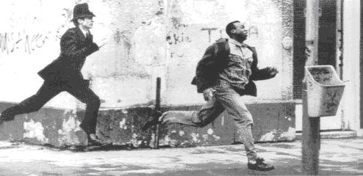
Mind’s On: What’s Happening?

Slide 2
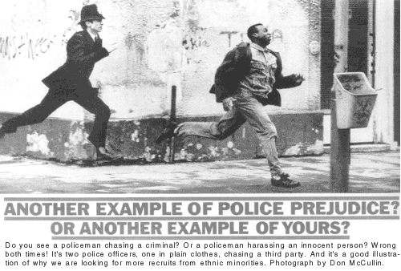

Slide 3
Theories of Prejudice and Discrimination

Slide 4
Video: Racism in Canada
Quick Agree/Disagree
Our diversity is a national strength
Overall, Canada has deeply engrained racism and discrimination that will never go away

Slide 5
Process of Discrimination
Stereotypes: False or generalized beliefs about a group of people; these categorize members without regard for individual differences.
Prejudice: A rigid generalization about an entire category of people; refers to attitudes and builds off of stereotypes.
Discrimination: Inequitable treatment of people based on their race, faith, gender, sexual orientation, nationality, etc.; refers to action.
Systemic Discrimination: Policies or practices in an organization that allow for inequitable treatment to occur; refers to bias in attitudes and actions in our societal institutions.
Genocide: The most extreme form of systemic discrimination; it’s the systematic destruction of an identifiable group

Slide 6
Competition Theory
This idea states that many people who feel inferior or threatened by a particular group compensate by putting down that group of people.
Prejudice occurs when frustrated and disadvantaged groups unfairly blame others for their situation.

Slide 7
Perceived Threat
When people have negative fearful connections to individuals and/or localized groups, and then transfer their impressions of these individuals to the entire group.
The prejudice is then generalized to the whole group of people.

Slide 8
Social Learning Theory
This idea is based on the belief that we tend to replicate attitudes and actions we see in our lives.
This may come from different forms of media or parental attitudes and actions, especially when children lack a full understanding of the social connotations behind prejudicial beliefs.

Slide 9
Lack of Interaction
This idea infers that people tend to dislike groups of people that are unfamiliar to them (for example, other ethnic groups, different sexualities, other social classes).
Lack of interaction → misunderstanding of cultural meanings → leads to conflict → development of prejudicial attitudes.

Slide 10
Video/Theory Connect
Under your note just write the title Are We Racist? (The National, CBC) and write down the names of the different theories
Under each theory write down examples from the documentary and/or the overall issue that connect to each

