Slide 1
Minds On – Picture Discuss
Check out the following pics with the people around you. Think about what women are wearing, how they are posed, they situation they are in, etc. What might these tell us about the view towards women in the 1920s?

Slide 3
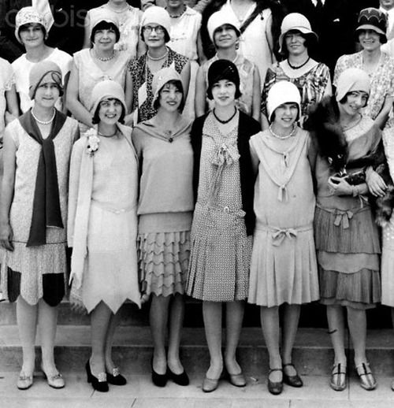

Slide 4
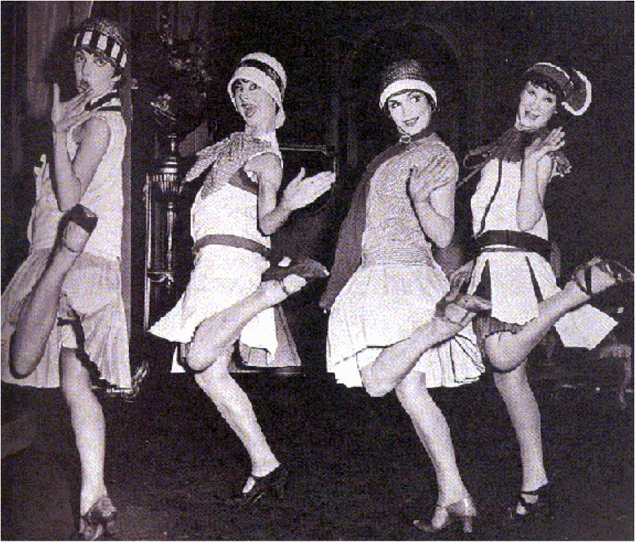

Slide 5
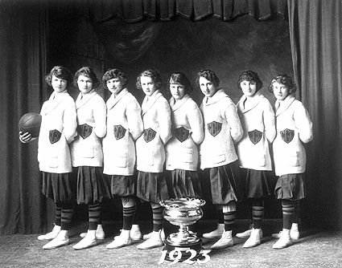
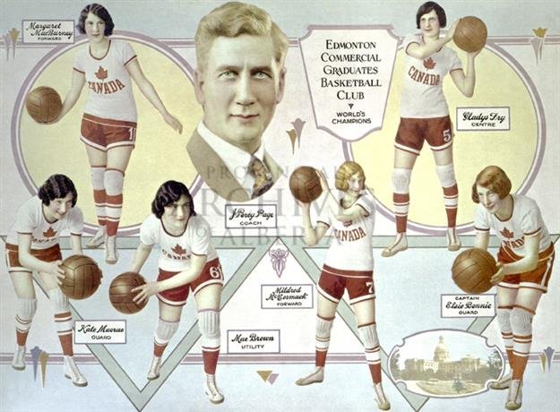

Slide 6
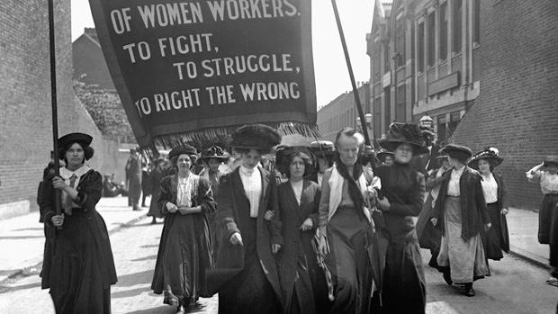

Slide 7
The Persons Case: A Social and Political Movement

Slide 8
Women were very active in the ‘first wave’ of feminism during early 1900’s
Volunteering, church organizations, temperance, child welfare, etc. were all considerable issues
In the eyes of the law… the BNA Act recognizes an individual as ‘he’ and a group of individual as ‘persons’
And… According to the Election Act of Canada, “no woman, idiot, lunatic or criminal shall vote.”
Question: What does this suggest about women were viewed?

Slide 9
Who/Where/When – Agnes MacPhail was 1st women in Alberta to be appointed position of judge in 1916
What Happened? In 1916 her appointment was immediately challenged as only ‘qualified persons’ could hold such positions, and she was not a person under the law
Consequences (Short Term) – Along with support from Nellie McClung and the Famous Five the ‘Persons Case’ went to the Supreme Court of Canada and it was decided they were still not ‘persons’ (1928)
Consequences (Long Term) With the support of PM King they appealed to Supreme Court of Britain that they were declared persons (1929)

Slide 10
Primary Source Analysis
Send someone from your section up to grab the CSI books and turn to pg.30
Read Evidence 2.15 and answer #1 in the During Reading questions
Read the chapter, identify 5 important events for women’s rights and fill in the chart.
Event | Short Term Consequence | Long Term Consequence

Slide 11
Event | Short Term Consequence | Long Term Consequence

Slide 12
Video Clip on Nellie McClung and the Famous Five

Slide 13
Wrap Up – Post It Exit
Read the following quote:
“A woman’s place is any
place she wants to be.”
Write down what your response to this quote would be if you lived in the 1920’s
Write down what your response to this quote is now

