Slide 1
Mind’s On – What’s in a Name?
Write down your parents, grandparents, and if you know them great-grandparents names.
Circle the ones that you think are super-cool, modern names. Underline the ones that are ‘old-sounding.’
For the old ones, how might the idea of PERSPECTIVE have been a factor in giving those names?

Slide 2
Defining Historical Perspective
There is a HUGE difference between current worldviews (beliefs, values and motivations) and those of earlier periods of history
As young historians we need to avoid Presentism – which means to use present (2017) ideas and customs on people and events of the past
There is, however, some value in applying the common experiences of humans in the present day and in the past (love, death, hunger)
We can relate to the past but we can’t think like the past
We can “infer” how people felt and thought in the past by understanding the context (the time period or event) and by assessing evidence

Slide 3
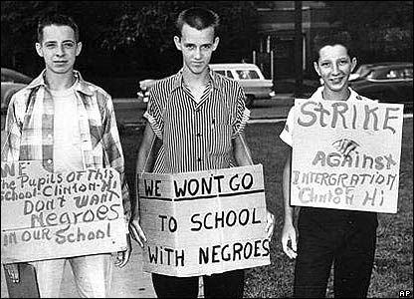
Picture Analysis
Use the inquiry questions on your sheet to guide your analysis of the following picture:
What is your immediate response to this picture?
What is their perspective on this issue?
What can we understand about that time based on their perspective?
If these people were transported to the present what do you think their reaction would be?

Slide 4
Canada Enter the War
Big Questions – 2,3
HTC – Using Sources

Slide 5
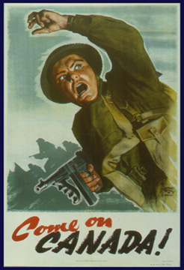
Quick Discuss: If you were a young Canadian man in 1914 for what reasons would you choose to join or not join?

Slide 6
As a former colony, Great Britain still controlled our foreign policy
Support for war in Canada was overwhelming – We saw it as our duty (politically and socially)
We immediately offered 25,000 soldiers despite having an army of only 3000
People enlisted because:
They thought it would be a quick victory
A sense of adventure
A chance to support Canada while being loyal to Britain
A paycheck ($1 a day!)

Slide 7
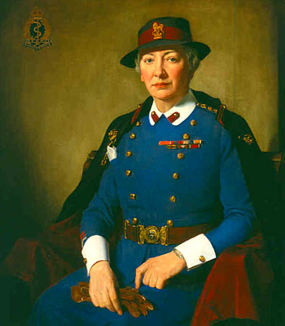
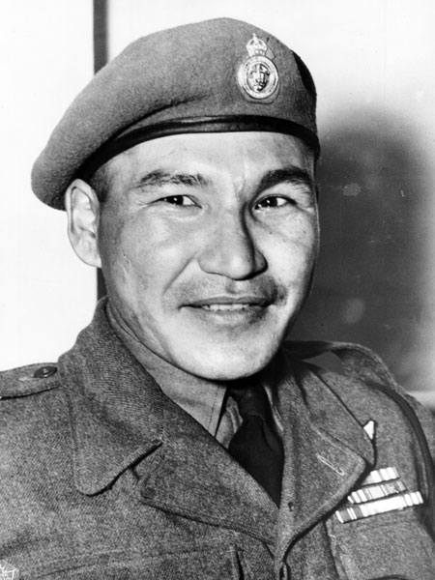
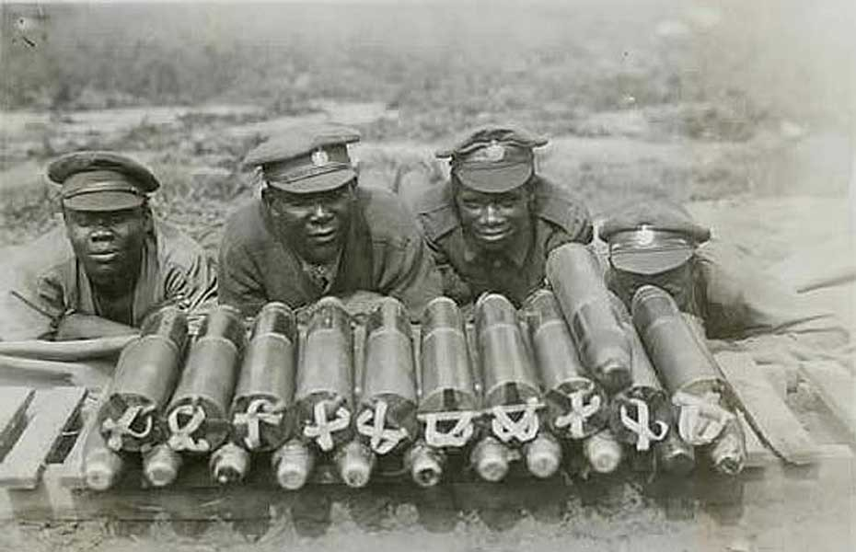
Not everyone was welcomed: women could not enlist but were expected to encourage husbands and brothers to do so
Some women became nurses, mechanics, etc. to support the troops
Aboriginal Canadians were not required to enlist; many did anyway
Most Black Canadians who tried to enlist were rejected; later they were given their own battalion due to racist attitudes of the time

Slide 8
Two Leaders – Two Sides
Robert Borden
Prime Minister of Canada 1911-1920
Was Canada’s PM throughout WW1
Introduced many defining changes (conscription, war tax, etc.) to Canada while helping us through wartime
Wilfrid Laurier
Prime Minister of Canada 1896-1911
Canada’s 1st French-Canadian PM, also our first Liberal
Ushered in a new era of growth and change

Slide 9
Using Primary Sources as Evidence
Set up the t-chart you see in your notes
Read Evidence 1.5 and 1.6 in the CSI textbook (pg. 5) and answer the questions (in red) in the chart
Think About This: So how is Canada going to get people to join?
Robert Borden | Wilfrid Laurier

Slide 10
Propaganda is a vital tool in advertisements, news, media, wartime, etc. It is convincing people of something that might not have previously believed to achieve a specific goal
PM Robert Borden used propaganda to support the idea of “total war” – That all citizens are needed to play a role
It could also be negative in that it was used to incite hatred of the enemy and create shame among other Canadians
The main uses of propaganda were to:
finance the war (Victory Bonds)
increase production,
raise money for support at home (Canadian Patriotic Fund)
recruitment

Slide 11
Source Analysis – Propaganda Posters
With a small group you will analyze a propaganda poster according to the following criteria:
Initial Observations: What do you see? What images are used? What text is used? Is there any action? Look for small details too!
Inferences: What might the things you see reveal? What can we assume? If they are asking for something specific why might that be? Are there any relationships to consider? Do you think it was effective?
Perspectives: What might this poster reveal about that time period? Are there any hints at the morals or perspectives of the time? Would this poster be effective today?

Slide 12
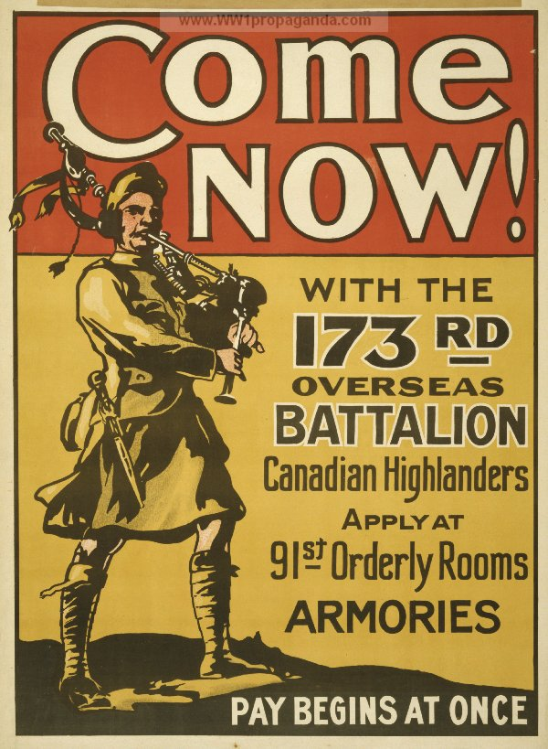
Initial Observations:
Inferences
Perspectives

Slide 13
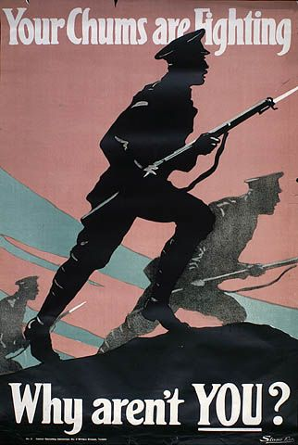
Initial Observations:
Inferences
Perspectives

Slide 14
Initial Observations:
Inferences
Perspectives

Slide 15
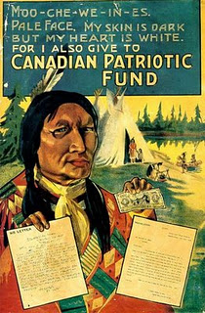
Initial Observations:
Inferences
Perspectives

Slide 16
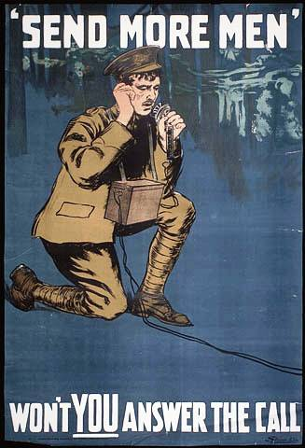
Initial Observations:
Inferences
Perspectives

Slide 17
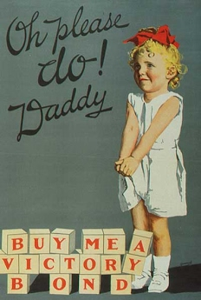
Initial Observations:
Inferences
Perspectives

Slide 18
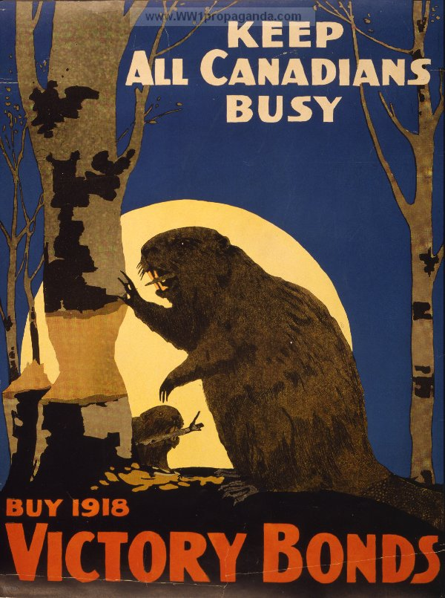
Initial Observations:
Inferences
Perspectives

Slide 19
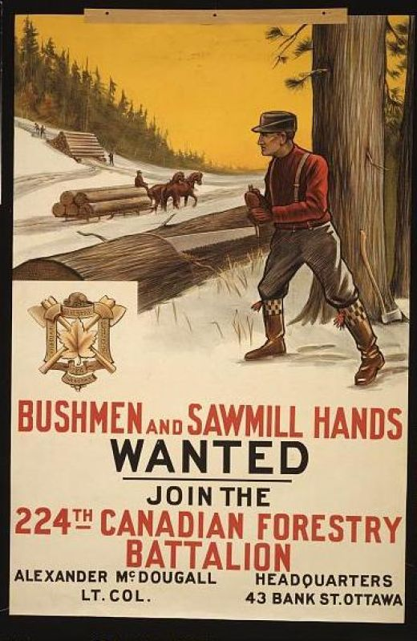
Initial Observations:
Inferences
Perspectives

Slide 20
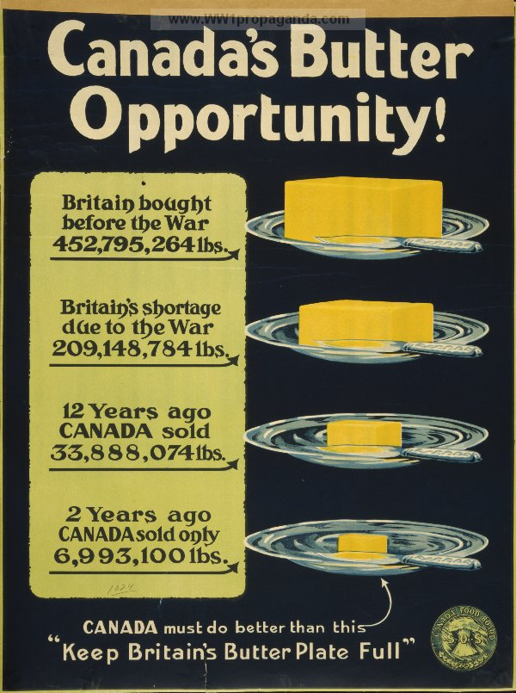
Initial Observations:
Inferences
Perspectives

Slide 21
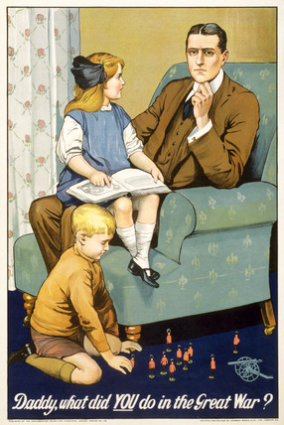
Initial Observations:
Inferences
Perspectives

Slide 22
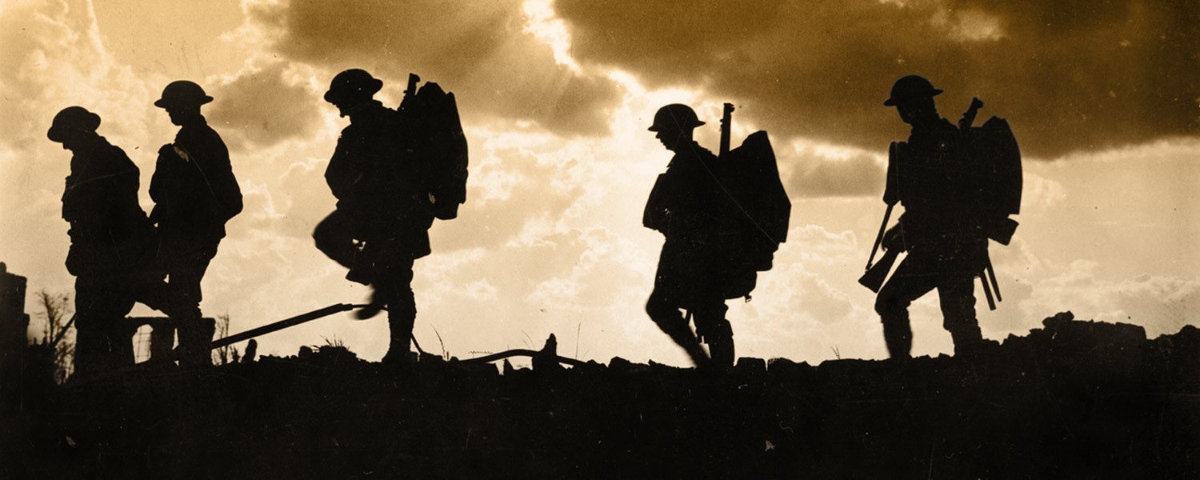
Wrap Up – Would You Go?
Simple: After looking at all of these posters, imagine you’re alive and of age to serve in 1914. Which one would be most likely to convince you to go to war?

